Slide 1
Notes:
https://www.sharilevitin.com/blog-news/sales-presentations/ask-more-questions/
https://www.inc.com/lee-colan/4-questions-great-leaders-ask.html

Slide 2
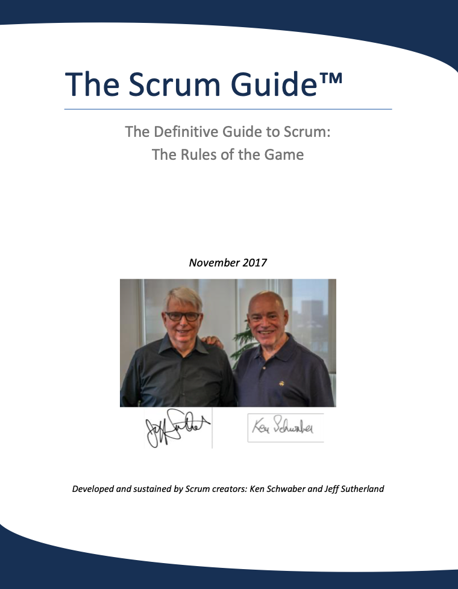

Slide 3
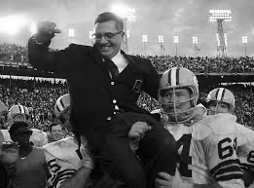
“Gentlemen, this is a football”
-Vince Lombardi

Slide 4
Scrum Values

Slide 5
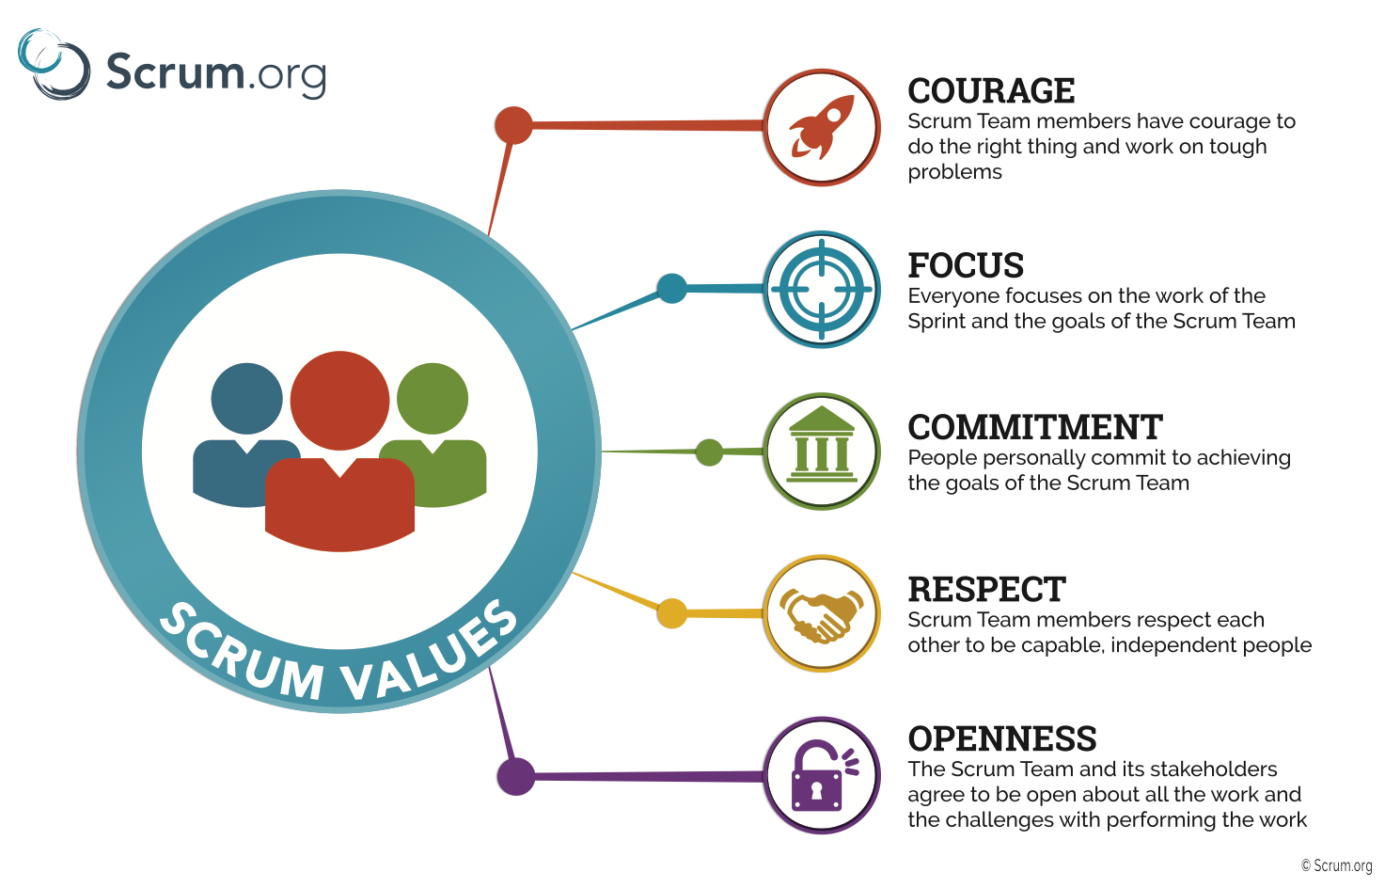

Slide 6
Courage
The Scrum value of courage is critical to an agile team’s success. Scrum teams must feel safe enough to say no, to ask for help, and to try new things. Teams must be brave enough to question the status quo when it hampers their ability to succeed.
Notes:
Why do you think this is important?
What’s it look like if it’s not present?
How could you demonstrate this to your team?
What would happen if you did that?
How could you encourage your team to demonstrate this value?

Slide 7
Discussion
Why do you think this is important?
What’s it look like if it’s not present?
How could you demonstrate this to your team?
What would happen if you did that?
What are some ways you could encourage your team to grow in this value?
What’s one thing you can do this next month to help your team with this value?

Slide 8
Focus
The Scrum value of focus is one of the best skills Scrum teams can develop. Focus means that whatever Scrum teams start they finish--so teams are relentless about limiting the amount of work in process (limit WIP).

Slide 9
Discussion
Why do you think this is important?
What’s it look like if it’s not present?
How could you demonstrate this to your team?
What would happen if you did that?
What are some ways you could encourage your team to grow in this value?
What’s one thing you can do this next month to help your team with this value?

Slide 10
Commitment
The Scrum value of commitment is essential for building an agile culture. Scrum teams work together as a unit. This means that teams trust each other to follow through on what they say they are going to do. When team members aren’t sure how work is going, they ask. Teams only agree to take on work they believe they can complete, so they are careful not to overcommit.

Slide 11
Discussion
Why do you think this is important?
What’s it look like if it’s not present?
How could you demonstrate this to your team?
What would happen if you did that?
What are some ways you could encourage your team to grow in this value?
What’s one thing you can do this next month to help your team with this value?

Slide 12
Respect
Team members demonstrate respect to one another, to the product owner, to stakeholders, and to the ScrumMaster. Teams know that their strength lies in how well they collaborate, and that everyone has a distinct contribution to make toward completing the work of the sprint. They respect each other’s ideas, give each other permission to have a bad day once in a while, and recognize each other’s accomplishments.

Slide 13
Discussion
Why do you think this is important?
What’s it look like if it’s not present?
How could you demonstrate this to your team?
What would happen if you did that?
What are some ways you could encourage your team to grow in this value?
What’s one thing you can do this next month to help your team with this value?

Slide 14
Openness
Scrum teams consistently seek out new ideas and opportunities to learn. Teams are also honest when they need help.

Slide 15
Discussion
Why do you think this is important?
What’s it look like if it’s not present?
How could you demonstrate this to your team?
What would happen if you did that?
What are some ways you could encourage your team to grow in this value?
What’s one thing you can do this next month to help your team with this value?

