Slide 1
Community
Your key to personal and professional success

Slide 2
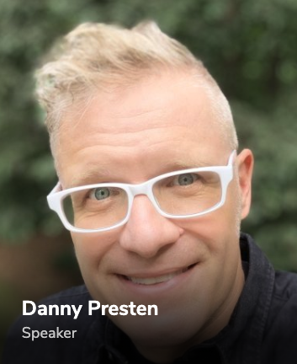
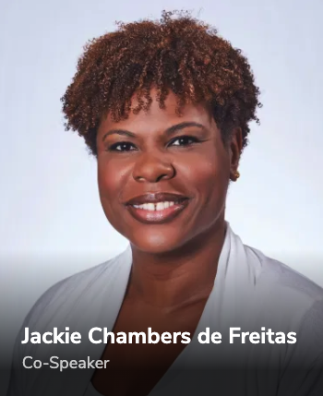
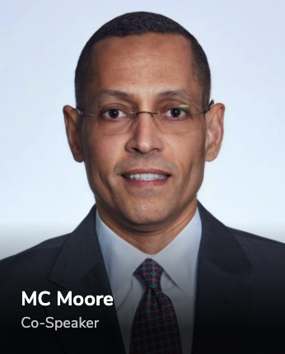
and…all of you via chat
Introductions

Slide 3
Why do you think community is so important?
What has worked/not worked?
Why isn’t this easier?
What are some practical takeaways I can do today?

Slide 4
Why do you think community is so important?

Slide 5
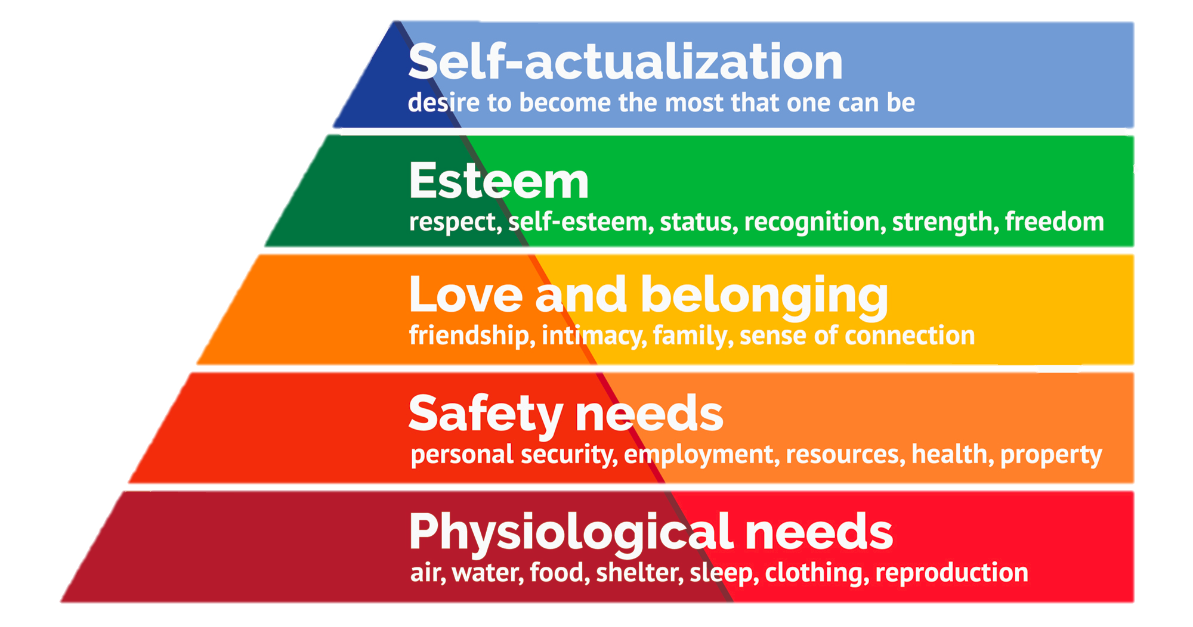

Slide 6
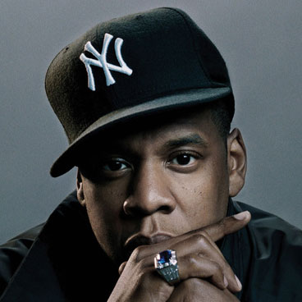
“we change people through
conversation…”
-Jay Z

Slide 7
“we change people through
conversation…”
-Jay Z

Slide 8
Why isn’t this easier?

Slide 9
Why isn’t this easier?
We’re overloaded with work
I’ll get to it tomorrow
Don’t want to bother anyone
I don’t get much out of it
It becomes a chore
Notes:
Jackie – becomes a chore
MC – Get to it tomorrow

Slide 10
What has worked/not worked?

Slide 11
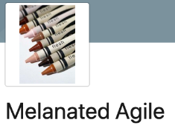
Personal
Professional
Workplace
Internal
Notes:
Meetup – also different geographies

Slide 12
What are some practical takeaways I can do today?

Slide 13
Experiment
Notes:
Master Remote – Jackie
Small isn’t bad – Danny
Get Invested – MC
Mix it up at your company- Danny

Slide 14
Q&A

Slide 15
Community
Your key to personal and professional success

