Slide 1
The Rise of Business Agility
Notes:
A few notes before we dive into the presentation today
This webinar will last approximately 60 minutes
We will be addressing questions at the end of the webinar today so please use the chat feature located in the lower left-hand corner of your screen to submit questions along the way
Today’s webinar is being recorded, and we will be sending a link to the recording and the slides.
Information for claiming PDU or SEU credits will be sent in the post-webinar email as well

Slide 2
Business Agility How deep does the rabbit hole go?

Slide 3
Business Agility The Ultimate Agile End Game

Slide 4
The Rise of Business Agility
Notes:
A few notes before we dive into the presentation today
This webinar will last approximately 60 minutes
We will be addressing questions at the end of the webinar today so please use the chat feature located in the lower left-hand corner of your screen to submit questions along the way
Today’s webinar is being recorded, and we will be sending a link to the recording and the slides.
Information for claiming PDU or SEU credits will be sent in the post-webinar email as well

Slide 5
Introductions
Danny Presten
Chief Methodologist
Notes:
And now without further ado, I will turn it over to our presenter, Danny Presten, Danny welcome!

Slide 6
Why adopt Agile in the first place?

Slide 8
Transparency
Speed to Market
Predictability
Prioritization

Slide 9
Sr. Leaders
PMO
Security
Sales
Product
Data/Analytics
Software Dev
Marketing
Hardware Dev
Operations
Finance
Legal
Infrastructure
HR
Vendors
Concept
Cash
Notes:
The “RIGHT” way to do this is to take a narrow slice of the org and get everyone involved
BUT most people don’t do that and have to start somewhere before they can go everywhere

Slide 10
Rey I want you to join me…we can bring a new order of waterfall to the galaxy
Don’t do this Kylo, you know where that leads, the decision has been made...we’re going agile

Slide 11
Software Dev
Concept
Cash
Notes:
The “RIGHT” way to do this is to take a narrow slice of the org and get everyone involved
BUT most people don’t do that and have to start somewhere before they can go everywhere

Slide 12
Product
Software Dev
Concept
Cash
Notes:
Product realizes they can’t do PRD/MRD documents and dump them over the fence, they’ve gotta get connected to the dev org

Slide 13
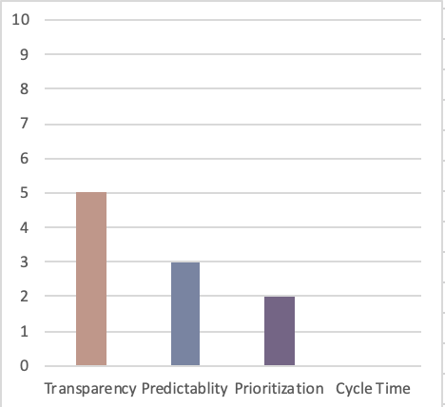
Early steps
IT sees some wins, gets more transparent
When they trust capacity limitations Product begins to prioritize
Still not getting significant speed to cash
Key Focus – Make work visible
Notes:
Lot’s of agile transformations die here
Leadership say’s “It didn’t work” or Leadership transitions before change takes hold

Slide 14
Sr. Leaders
PMO
Product
Software Dev
Finance
HR
Concept
Cash
Notes:
Finance – Funding Change….also cap story pts
SLT – Bigger than they thought, tighter engagement and more delegation
HR – New job titles, don’t mix ‘em!
PMO – Stop tracking budget do manage portfolio investments and prioritization

Slide 15
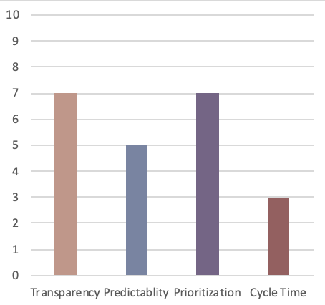
Beginning to grow in understanding
Begin to fund teams instead of scope this accelerates speed to cash
Visit hiring practices
Still lacking key areas
Key Focus : Limit WIP
Notes:
This may take years but if you can get here usually things take hold and can mature

Slide 16
Sr. Leaders
PMO
Security
Sales
Product
Data/Analytics
Software Dev
Marketing
Hardware Dev
Operations
Finance
Infrastructure
HR
Concept
Cash
Notes:
Infra- move to the cloud, this should be much easier as orgs mature
Biz ops/IT Ops
Security iterates with team instead of batch reviews
Sales adjusts to more frequent deliveries also gets closer to customer and partners with Product

Slide 17
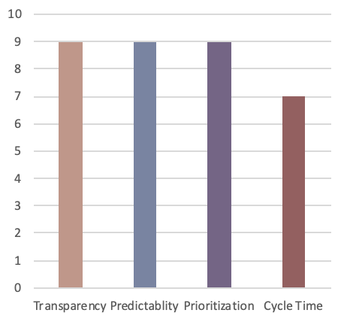
Building on Success
Other areas begin to join in and see benefits
Reorganize around value
Expand ALM ecosystem
Key Action – Optimize full Value Stream
Notes:
At this stage the organization is getting significant wins
Usually by this time engineering has embraced devops and speed to production is dramatically reduced

Slide 18
Sr. Leaders
PMO
Security
Sales
Product
Data/Analytics
Software Dev
Marketing
Hardware Dev
Operations
Finance
Legal
Infrastructure
HR
Vendors
Concept
Cash
Notes:
Legal does iterative reviews as well as changes contract (fixed SOW to T&M)
HR changes reviews -> team based
Vendors adopt organization way of working

Slide 19
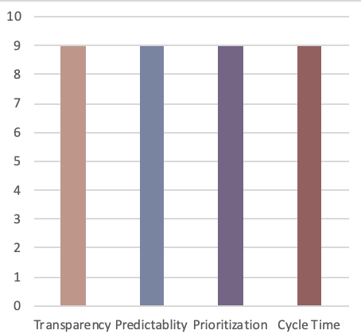
Business is becoming agile
High performing teams
Ability to pivot and respond to market demands
Delivering highest value items with sustainably shortest lead time
Key Focus – Build Culture

Slide 21
For Discussion
Where is your company currently?
What steps do you need to take to get more value from your delivery process?

Slide 22
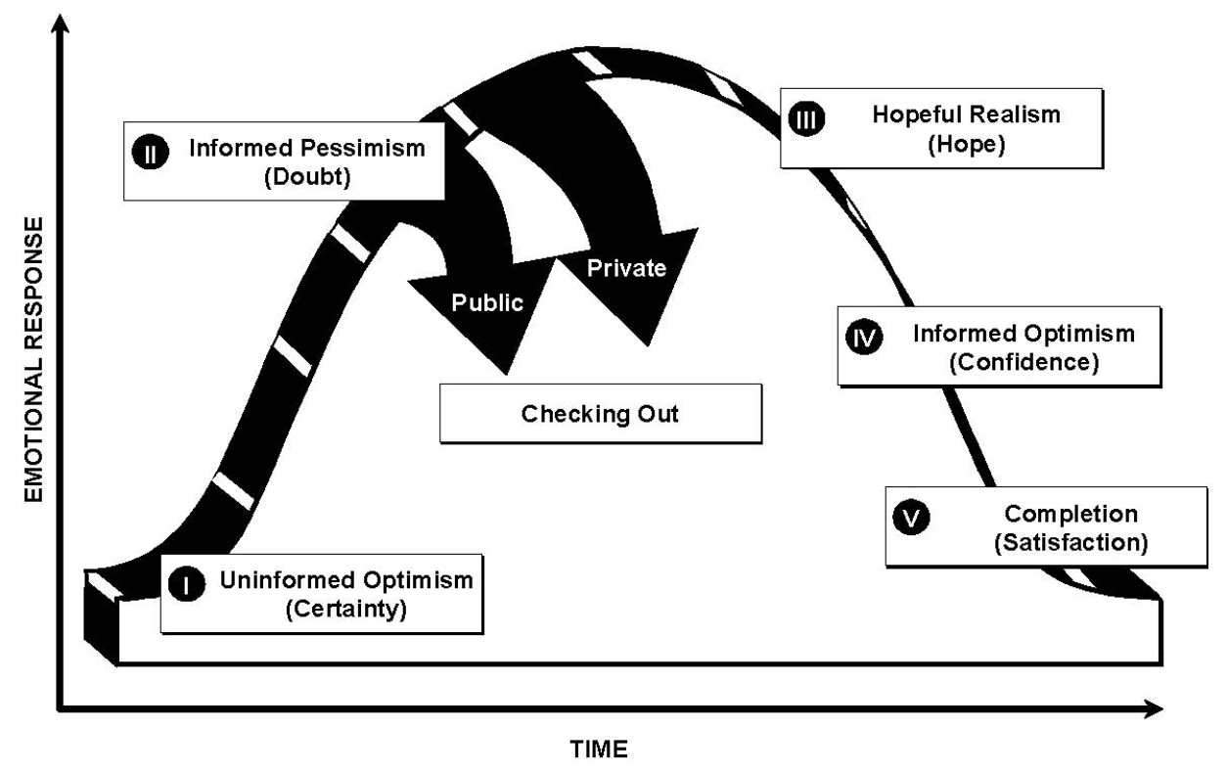
Daryl Conner ”Managing at the Speed of Change”

Slide 23
For Discussion
Where is your organization emotionally?
What steps do you need to take to move them to the next stage?

Slide 24
The Rise of Business Agility
Notes:
A few notes before we dive into the presentation today
This webinar will last approximately 60 minutes
We will be addressing questions at the end of the webinar today so please use the chat feature located in the lower left-hand corner of your screen to submit questions along the way
Today’s webinar is being recorded, and we will be sending a link to the recording and the slides.
Information for claiming PDU or SEU credits will be sent in the post-webinar email as well

