Slide 1
Business Agility How deep does the rabbit hole go?

Slide 2
Business Agility The Ultimate Agile End Game

Slide 3
Why adopt Agile in the first place?

Slide 4
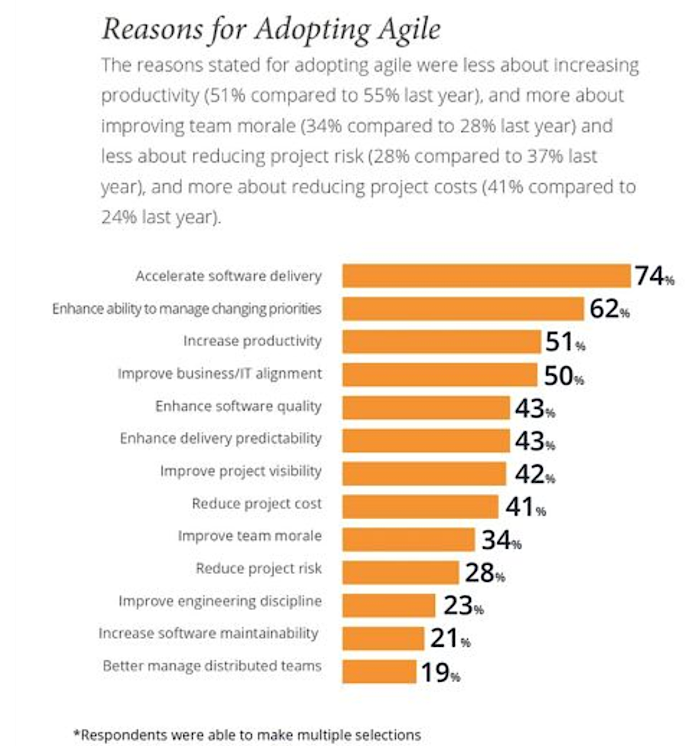

Slide 5
Transparency
Speed to Market
Predictability
Prioritization

Slide 6
Sr. Leaders
PMO
Security
Sales
Product
Data/Analytics
Software Dev
Marketing
Hardware Dev
Operations
Finance
Legal
Infrastructure
HR
Vendors
Concept
Cash
Notes:
The “RIGHT” way to do this is to take a narrow slice of the org and get everyone involved
BUT most people don’t do that and have to start somewhere before they can go everywhere

Slide 7
“This is your last chance. After this, there is no turning back. You take the blue pill the story ends, you wake up in your bed and believe whatever you want to believe. You take the red pill you stay in Wonderland, and I show you how deep the rabbit hole goes. Remember: all I'm offering is the truth”

Slide 8
Software Dev
Concept
Cash
Notes:
The “RIGHT” way to do this is to take a narrow slice of the org and get everyone involved
BUT most people don’t do that and have to start somewhere before they can go everywhere

Slide 9
Product
Software Dev
Concept
Cash
Notes:
Product realizes they can’t do PRD/MRD documents and dump them over the fence, they’ve gotta get connected to the dev org

Slide 10
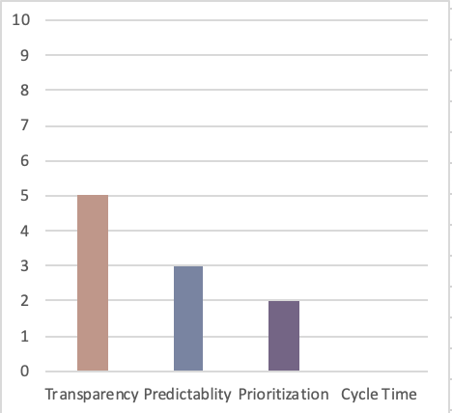
Early steps
IT sees some wins, gets more transparent
When they trust capacity limitations Product begins to prioritize
Still not getting significant speed to cash
Key Focus – Make work visible
Notes:
Lot’s of agile transformations die here
Leadership say’s “It didn’t work” or Leadership transitions before change takes hold

Slide 11
Sr. Leaders
PMO
Product
Software Dev
Finance
HR
Concept
Cash
Notes:
Finance – Funding Change….also cap story pts
SLT – Bigger than they thought, tighter engagement and more delegation
HR – New job titles, don’t mix ‘em!
PMO – Stop tracking budget do manage portfolio investments and prioritization

Slide 12
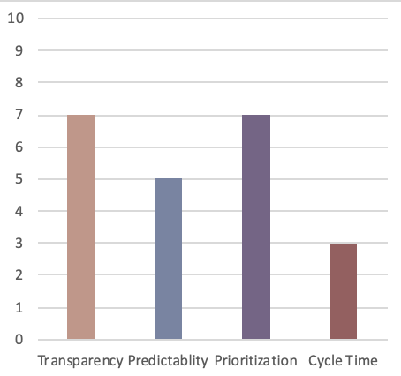
Beginning to grow in understanding
Begin to fund teams instead of scope this accelerates speed to cash
Visit hiring practices
Still lacking key areas
Key Focus : Limit WIP
Notes:
This may take years but if you can get here usually things take hold and can mature

Slide 13
Sr. Leaders
PMO
Security
Sales
Product
Data/Analytics
Software Dev
Marketing
Hardware Dev
Operations
Finance
Infrastructure
HR
Concept
Cash
Notes:
Infra- move to the cloud, this should be much easier as orgs mature
Biz ops/IT Ops
Security iterates with team instead of batch reviews
Sales adjusts to more frequent deliveries also gets closer to customer and partners with Product

Slide 14
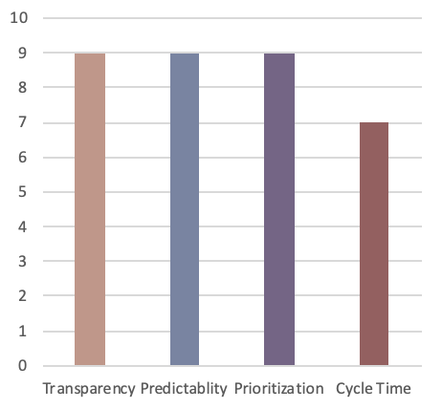
Building on Success
Other areas begin to join in and see benefits
Reorganize around value
Key Action – Optimize full Value Stream
Notes:
At this stage the organization is getting significant wins
Usually by this time engineering has embraced devops and speed to production is dramatically reduced

Slide 15
Sr. Leaders
PMO
Security
Sales
Product
Data/Analytics
Software Dev
Marketing
Hardware Dev
Operations
Finance
Legal
Infrastructure
HR
Vendors
Concept
Cash
Notes:
Legal does iterative reviews as well as changes contract (fixed SOW to T&M)
HR changes reviews -> team based
Vendors adopt organization way of working

Slide 16
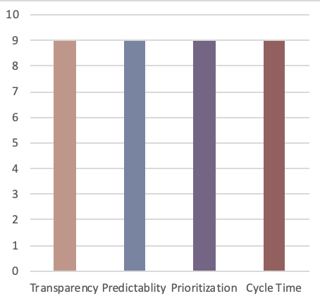
Business is becoming agile
High performing teams
Ability to pivot and respond to market demands
Delivering highest value items with sustainably shortest lead time
Key Focus – Build Culture

Slide 18
Discussion
Where is your company currently?
What steps do you need to take to get more value from your delivery process?

Slide 19
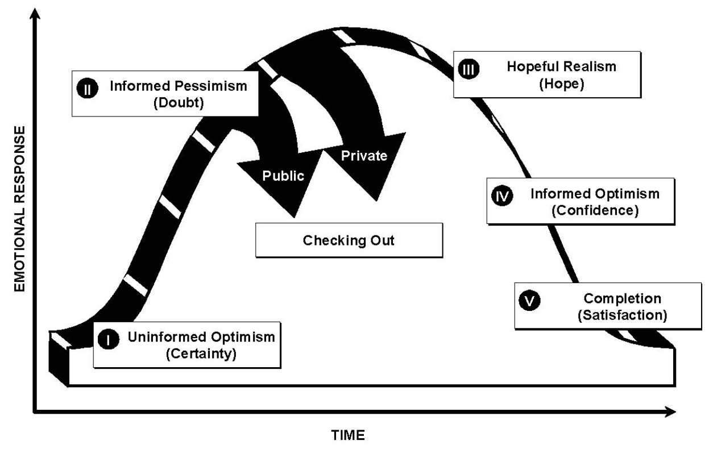
Daryl Conner ”Managing at the Speed of Change”

Slide 20
Discussion
Where is your organization emotionally?
What steps do you need to take to move them to the next stage?

Slide 21
What’s the one thing you can do such that by doing it everything becomes easier?

Slide 22
www.agileoctane.com
CoP’s
Meetups
Conferences
Job aids
Slack group
Training
Fun

