Slide 1
Scrum/Kanban Overview

Slide 2
Introduction to Scrum
Notes:
[Bill]

Slide 3
Scrum Discovery
Make a poster of what your team currently does regarding
Roles
Ceremonies
Other recurring mtgs
Artifacts

Slide 4
Scrum Roles
Notes:
[Bill]

Slide 5
Scrum Roles
Scrum Master: Accountable for facilitating, mentoring and enacting effective Scrum
Situational servant-leader.
Scrum Master
Product Owner: Accountable for maximizing the value of the work.
Knowledgeable and available.
Scrum
Team
Development Team: Accountable for the delivery of value.
Cross-functional and self-organizing.
Product Owner
Dev Team

Slide 6
Scrum in Action
Notes:
[Bill]

Slide 7
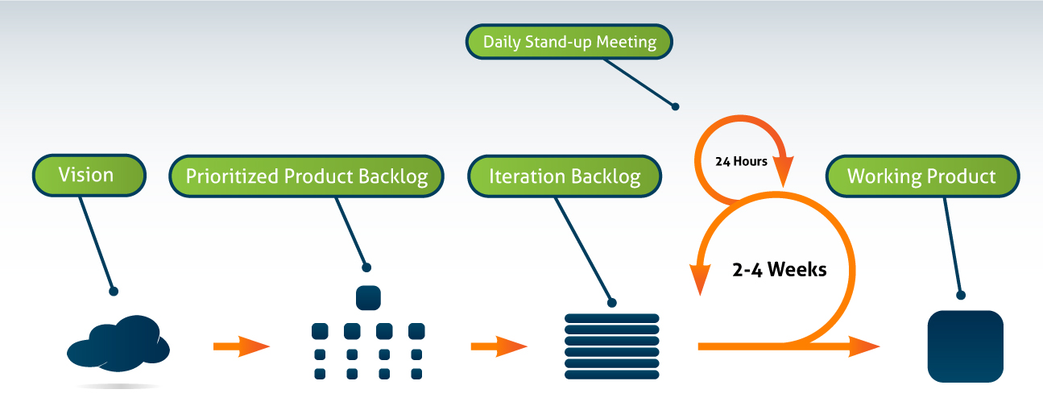
Scrum in Action
Product Vision
Understanding why we are doing what we are doing, who it is for, and the overall market opportunity
Product Backlog
The master list of things that we want to build into the product
Feedback Loops
Review and Retro
“Done” Working Product
Is the primary measure of progress at the end of each Sprint
Refinement
Teams typically devote up to 10% of their time to this
Notes:
3 stickies – roles
3 stickies – artifacts
5 stickies – events

Slide 8
Sprint Planning

Slide 9
Sprint Planning
What to build… how to build it
Understanding our user stories
Decide how much the team can do
Craft a Sprint Goal
Notes:
Talk to the Product Owner about each user story.
Regarding breaking down into tasks… estimating tasks (in real hours)….
** coming up with the tasks is not the goal! Purpose is to see what we can commit to.
(more detailed is good, but takes time to learn and time to do and brings into question when to do sprint commitment)
(high level: design, review design, code, write acceptance test)
(detailed level: introduce foo.class w/ stubbs, introduce xxx pattern, move yyy#method to foo, extract something from…,
implement stubbed methods, hook up new structure, write this AT and that AT)
Sprint backlog, burn down hours
(bring up question of to do hours or make each task the same size: 1-2 hrs, 4 hrs, pomodoro)
Figuring out who can do what… pulling the work… assessing capacity
Making sure that we can make a good sprint commitment.
*** TEAM SAYS WHAT THEY CAN DO! Not SM, not PO, not MGR.

Slide 10
Discussion
Do you typically do sprint objectives? Why or Why not?
What is your team’s velocity? How do you know?
Is it clear what stories are prioritized and why?
Does your team typically use tasks? Why or Why not?
Notes:
See Exercise - Sprint Planning.doc
Provide to the team:
Sprint objectives
Historical velocity
High level systems architecture
Sample tasks and estimates
As a product owner, I’ll define release goals around something like logging into the system
Have them take the stories that they selected for release planning and pull out the ones for login
Given them a varying historical velocity, have them select how much they are going to deliver
Have them select from a list of tasks that might be appropriate
Estimate the tasks in real hours?? AF: Whenever I do this exercise, the math never works out…. the task estimates and the number of developers and the story estimates never match up and it creates confusion that may not be worth the time it takes to estimate the tasks in the course. But it’s important to see people estimate tasks and learn to split them if they are 6 hours or more. Need to find a better way to do this.
DEBRIEF:
Which stories?
Did you do the login or bill payment?
What do you think about PO wanting login but reduce risk (bill payment)?
Did you consider that the PO might have been missing that could do login later?
How many points did you plan? Why that many? Average, low, high velocity? Based on hours capacity?
What are some of your tasks? (share with rest of room)
How many hours are estimated for those tasks?
What is your team’s capacity in hours?

Slide 11
Daily Scrum

Slide 12
Daily Scrum (Stand-up) Meeting
Why a daily cadence?
Use these three questions as a guide:
What did I do yesterday that helped the Development Team meet the Sprint Goal?
What will I do today to help the Development Team meet the Sprint Goal?
Do I see any impediment that prevents me or the Development Team from meeting the Sprint Goal?
Assessing & tracking progress
Identifying impediments
Notes:
What did I accomplish yesterday? (Yesterday?)
What will I get done today? (Today?)
What obstacles are impeding my progress? (Impediments?)
When to meet
Where to meet
The three questions are a starting place
15 minutes?
Who leads it?
Distributed stand-up meetings
Do we have to have one?
-----------------
Come early & Observe the board – soak it in.
Orient yourself to the team's current state and update anything you have failed to update previously to the information,
establish an opinion as to what the team needs to do today.
Impediments first. (Is there anything going on that is going to put our delivery of this sprint in jeopardy? "Are we going to fail this Sprint?")
Followed by what's next.
Time permitting, acknowledge what's done.
The final question is to the whole team is, 'What strategy must we Decide on to be the most productive today?' Team discusses and a decision is made.
The team must then disperse and Act immediately.

Slide 13
Sprint Review

Slide 14
Sprint Review and Demo
Evaluating done
Customer acceptance
Assessing progress
Notes:
Put it on calendar. Regular meeting.
Recommend doing a dry-run.
Recommend having the PO do the demo to external stakeholders.
Don’t surprise the PO – or QA – they should see working software before the demo.
It might be that there is no one else to demo to other than the PO, but maybe there is: support, sales, other mgmt/stakeholders, external users/customers.
If not done, demo what is done.
Don’t count partially completed work in velocity.
Reestimate the remaining work for the incomplete story for the next sprint.
This is a good opportunity to update release burndown and reassess release backlog.
No credit for stories which are not done.
Need to ask why. How to prevent in future
Common pattern … too many stories being worked on concurrently.

Slide 15
Sprint Review and Demo
Who should attend?
How much Prep do you do?
What if it’s not done?
Notes:
Put it on calendar. Regular meeting.
Recommend doing a dry-run.
Recommend having the PO do the demo to external stakeholders.
Don’t surprise the PO – or QA – they should see working software before the demo.
It might be that there is no one else to demo to other than the PO, but maybe there is: support, sales, other mgmt/stakeholders, external users/customers.
If not done, demo what is done.
Don’t count partially completed work in velocity.
Reestimate the remaining work for the incomplete story for the next sprint.
This is a good opportunity to update release burndown and reassess release backlog.
No credit for stories which are not done.
Need to ask why. How to prevent in future
Common pattern … too many stories being worked on concurrently.

Slide 16
Retrospectives

Slide 17
Retrospectives
Inspect and adapt
What went well, could be better, things to try now
This is KEY to improving everywhere
Notes:
SAMOLO (Same As, More Of, Less Of)

Slide 18
Exercise: Retrospective
Draw the retrospective circle on a flip chart
Each team member writes at least one item in each category on a Post-It note and puts it in the circle
Dot vote – 3 votes each person
Create 1 – 2 action items for item with the most votes
Do more of
Do less of
Start doing
Stop doing
Notes:
This version of the exercise uses the More Of, Less Of, Start, Stop format.
I ask the “teams” to do a retrospective thinking about their current situation and identify items they want to do More Of, do Less Of, Start doing, and Stop doing.
Each person should come up with at least one item for each category.
Collapse duplicate items
Have them dot vote – 3 votes per person – which they can spread across the items any way they wish.
If the top voted item is something external to the team then put it outside the circle and determine who outside the team can escalate and then pick the next item.
If the top voted item is something the team can do then I ask them to explicitly define one or two action items they can accomplish in the next 2 weeks.
This I find is a good way to end the class. It helps them take what they have learned and leave with something actionable they can do.

Slide 19
Kanban – “Simple but not easy!”

Slide 20
Kanban Board – Making WIP visible
Discovery (3)
Delivery (5)
Ready (5)
UAT (3)
Ready for Release
Analyze
Ready for Dev
Dev
Ready for Accept
Feature
Feature
Feature
Feature
Feature
Feature
Feature
Feature
Feature
Feature
Feature
Feature
Columns for each Work Activity
Feature
Feature
Feature
Feature
Urgent
Design Complete
Test Case Examples Done
UIX Input Ready
Code Complete
Source Checked In
Unit Tests Green
Build Succeeds
Acceptance Tests Green
Manual Testing Okay
PO Acceptance
Doco Complete
Criteria

Slide 21
Kanban Board
Discovery (3)
Delivery (5)
Ready (5)
UAT (3)
Ready for Release
Analyze
Ready for Dev
Dev
Ready for Accept
Feature
Feature
Feature
Feature
Feature
Feature
Feature
Feature
Feature
Feature
Feature
Feature
WIP Limits –Maximum number of Kanban in each column
Feature
Feature
Feature
Feature
Urgent
Design Complete
Test Case Examples Done
UIX Input Ready
Code Complete
Source Checked In
Unit Tests Green
Build Succeeds
Acceptance Tests Green
Manual Testing Okay
PO Acceptance
Doco Complete
Criteria

Slide 22
Kanban Board
Discovery (3)
Delivery (5)
Ready (5)
UAT (3)
Ready for Release
Analyze
Ready for Dev
Dev
Ready for Accept
Feature
Feature
Feature
Feature
Feature
Feature
Feature
Feature
Feature
Feature
Feature
Feature
Feature
Feature
Shows Activity Status – doing and done
Feature
Feature
Urgent
Design Complete
Test Case Examples Done
UIX Input Ready
Code Complete
Source Checked In
Unit Tests Green
Build Succeeds
Acceptance Tests Green
Manual Testing Okay
PO Acceptance
Doco Complete
Criteria

Slide 23
Kanban Board
Discovery (3)
Delivery (5)
Ready (5)
UAT (3)
Ready for Release
Ready for Dev
Ready for Accept
Criteria for Done defined for each column
Analyze
Dev
Feature
Feature
Feature
Feature
Feature
Feature
Feature
Feature
Feature
Feature
Feature
Feature
Feature
Feature
Feature
Feature
Urgent
Design Complete
Test Case Examples Done
UIX Input Ready
Code Complete
Source Checked In
Unit Tests Green
Build Succeeds
Acceptance Tests Green
Manual Testing Okay
PO Acceptance
Doco Complete
Criteria

Slide 24
Kanban Board
Discovery (3)
Delivery (5)
Ready (5)
UAT (3)
Ready for Release
Analyze
Ready for Dev
Dev
Ready for Accept
Feature
Feature
Feature
Feature
Feature
Feature
Feature
Feature
Feature
Feature
Feature
Feature
Feature
Feature
Feature
Feature
Urgent
In this case, all the queues are full.
No more work can be added to the Kanban.
Design Complete
Test Case Examples Done
UIX Input Ready
Code Complete
Source Checked In
Unit Tests Green
Build Succeeds
Acceptance Tests Green
Manual Testing Okay
PO Acceptance
Doco Complete
Criteria

Slide 25
Cumulative Flow Diagram

Slide 26
Scrum helps fix Kanban challenges

