Slide 1
Program Prioritization

Slide 2
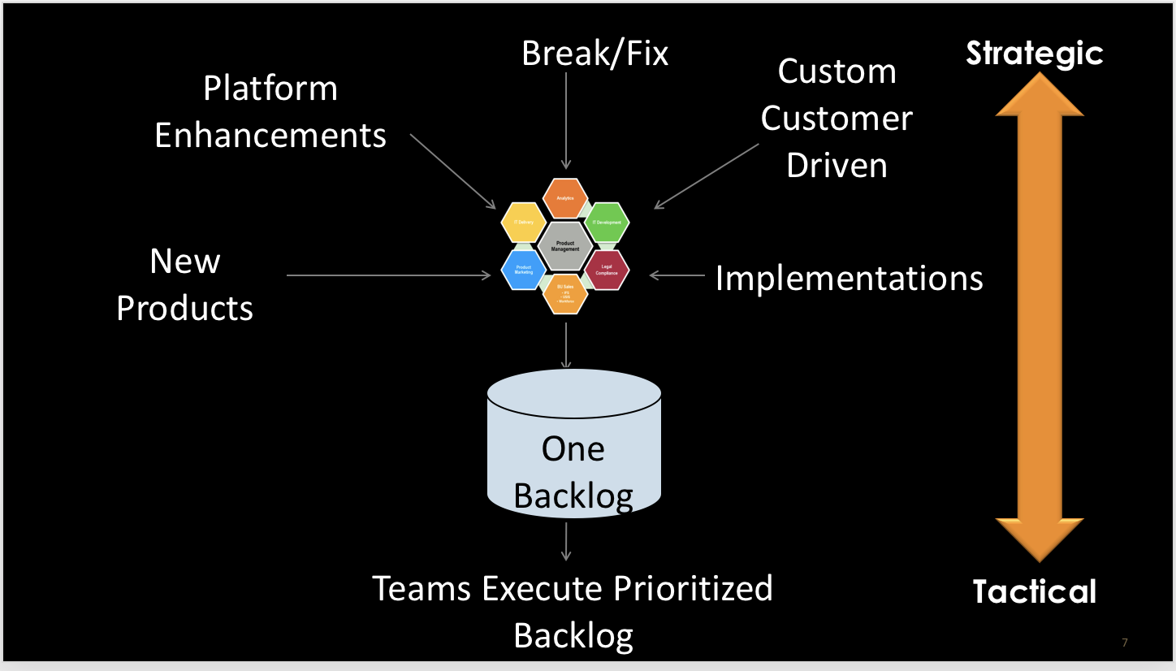
Prioritization Process
Product Roadmap
Enters single “front door”
Tracked on Program Kanban
Prioritization Decision
Input to PI planning
Committed Program Board

Slide 3
Product Roadmap
Committed |  |  | Proposed
Q3 |  |  | Q4 |  |  | Q1
Jul | Aug | Sept | Oct | Nov | Dec | Jan | Feb | Mar
Epic
Epic
Enabler
Epic
Epic
Epic
Enabler
Notes:
2017 Themes:
Deliver Insights
ANAV Trended Data Support
MIT Neural Net Support
KCP Deal Support (U.S. data sources)
Usability/Features (ANAV, MIT, & IG)
PPP MVP
Advanced Reporting
Invest in Capabilities and Scale
PaaS SLA Support & Delivery
New Acquisition GUI
Customer Account Mgmt MVP
Security/Compliance

Slide 4
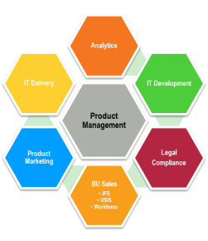
Break/Fix
Strategic
Custom Customer Driven
Platform Enhancements
New Products
Implementations
One Backlog
Teams Execute Prioritized Backlog
Tactical

Slide 5
Product Mgmt facilitates prioritization with delivery organization
Product Management
Analytics
IT Development
Legal
Compliance
BU Sales
Product Marketing
Operations
IFS
USIS
Workforce
Cross BU / COE involvement
Increases communication and improves alignment
Quarterly review of proposed priorities
Gain agreement from key stakeholders

Slide 6
For (customers) Who (do something) The (solution) is a (how) that (provides some value) Unlike (competition or current solution) Our solution (does something better, why?)
Example Epic Description

Slide 7
Connected Kanban's
Epics at Portfolio Level
New
Prioritized
In Process
Done
Features at Program Level
New
Prioritized
In Process
Done
Stories at Team Level
New
Prioritized
In Process
Done

Slide 8
Backlog Prioritization
New
Description
Acceptance Criteria
Sized
WSJF
Prioritized Next
In Process
Done
Feature
Feature
Feature
Feature
Feature
Feature
Feature
Feature
Feature
Feature
Feature
Meets definition of ready

Slide 9
What is (and isn’t) prioritized?
Based on this example the program has capacity for 100 points forcing the line to be drawn after Feature 8 for the quarter
 | Size | WSJF
Feature 4 | 10 | 21.0
Feature 13 | 20 | 6.5
Feature 12 | 10 | 6.0
Feature 2 | 30 | 5.0
Feature 8 | 30 | 5.0
Feature 1 | 20 | 4.5
Feature 7 | 20 | 4.5
Feature 5 | 40 | 2.8
Feature 10 | 80 | 2.6
Feature 3 | 50 | 2.0
Feature 9 | 50 | 2.0
Feature 6 | 50 | 1.2
Feature 11 | 130 | 0.8
This will become a basis for tradeoff discussions regarding priority, to put something else “in” something has to come “out”

Slide 10
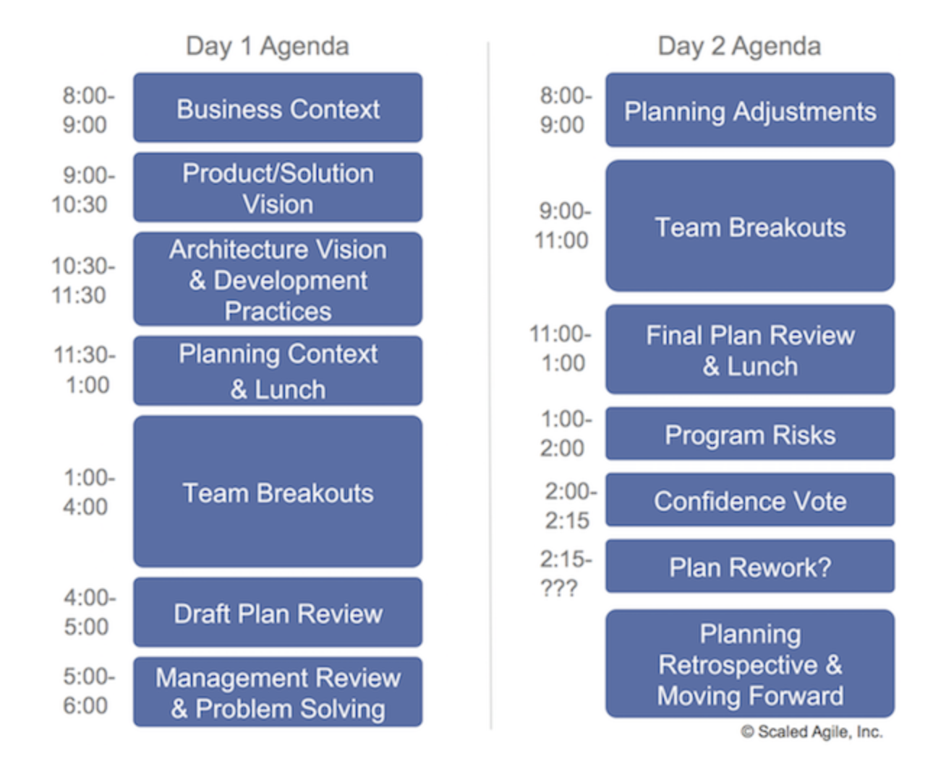
PI Planning Event

Slide 11
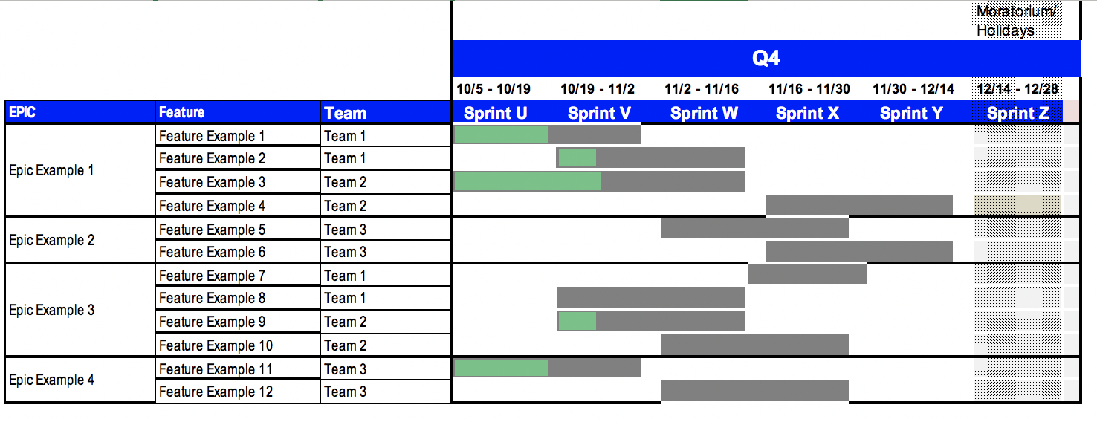
Post PI Planning Program Board
Notes:
Part of the “exit criteria” for PI planning is a a committed program board at the feature level.

