Slide 1
Agile Principles

Slide 2
Day 2
Why Agile?
SM Deep Dive
Foundational Principles
The Scrum Framework
Agile Leadership

Slide 3
Introductions
H
HELLO
MY NAME IS

Slide 4
Story writing
Work Carries over from Sprint to Sprint
Burndowns don’t burndown till the last day of the sprint
Stories not defined prior to bringing into a sprint
Clear definition of done
QA Issues
Long regression test cycles
Lack of QA resources
Develop a roadmap and execute predictably
Unclear Velocity
Prioritize the right work and do that first
Align to hardware milestones
Emergency work
Team
PO and SM know their roles and can do them
Teamwork and laying aside roles
Can SM rotate?
Engage offshore workers (esp getting QA embedded more on Scrum team)
Processes
How would you change things for small -> large teams
How to get code through peer review
Improve triage mtgs
Tools
KPI’s at team and program level to build C level dashboards

Slide 5
What do you want to get out of this time?
What are your biggest challenges?
Notes:
Questions:
Experience? Most /Least / Median
Team Type? Portfolio / Program / Delivery
(Optional) Write any Agile questions to cover on sheet of paper

Slide 6
Notes:
Talk about half life of requirements and why that led to shorter iterations and less up front design phases

Slide 7
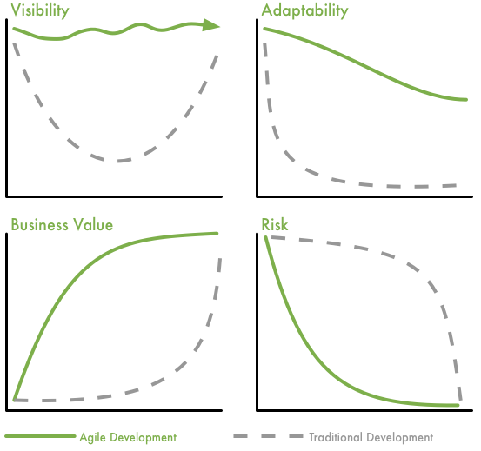
There are lots of other benefits
Notes:
So after talking to the participants about all these concepts this slides starts to show how agile can help with the challenges we are mentioned so far.
The first thing to bring to the participants attention is that Agile will not solve all your problems but will expose them. Part of reducing uncertainty is to see the problems early on and then take action to solve those challenges. The way Agile works is that it will give the team as well as management a whole new level of visibility. Traditionally the visibility is at the beginning of the project and at the end. In Agile the visibility is throughout the project because we are in a constant state of delivering and collaborating together.
The second advantage of agile is the delivery of business value earlier. Because we will deliver software earlier the business will realize value much earlier. In an traditional approach the business usually realizes the value at the end when everything is delivered at once.
Agile also helps with reducing risk early on. Agile teams tend to work on the items with the highest risk first and therefore reducing risk early on. Also related to the notion of IKIWISI, if customers get to see the work early on the can give more feedback and that again reduces the risk.
Agile will offer customers a new level of adaptability that is not common in the traditional world. In the traditional world the goal is to lock everything down and the beginning and then start working. In Agile the mindset is to keep our options open longer and commit to things at the last responsible moment .

Slide 8
What benefits do you want to see agile deliver?

Slide 9
Benefits of agile execution models
Transparency
Predictability
Prioritization
Faster Deliveries
Notes:
Ave Feature Cycle Time @ ATC before Agile (2013): 38 weeks
Ave Feature Cycle Time @ ATC (end 2015): 15 weeks

Slide 10
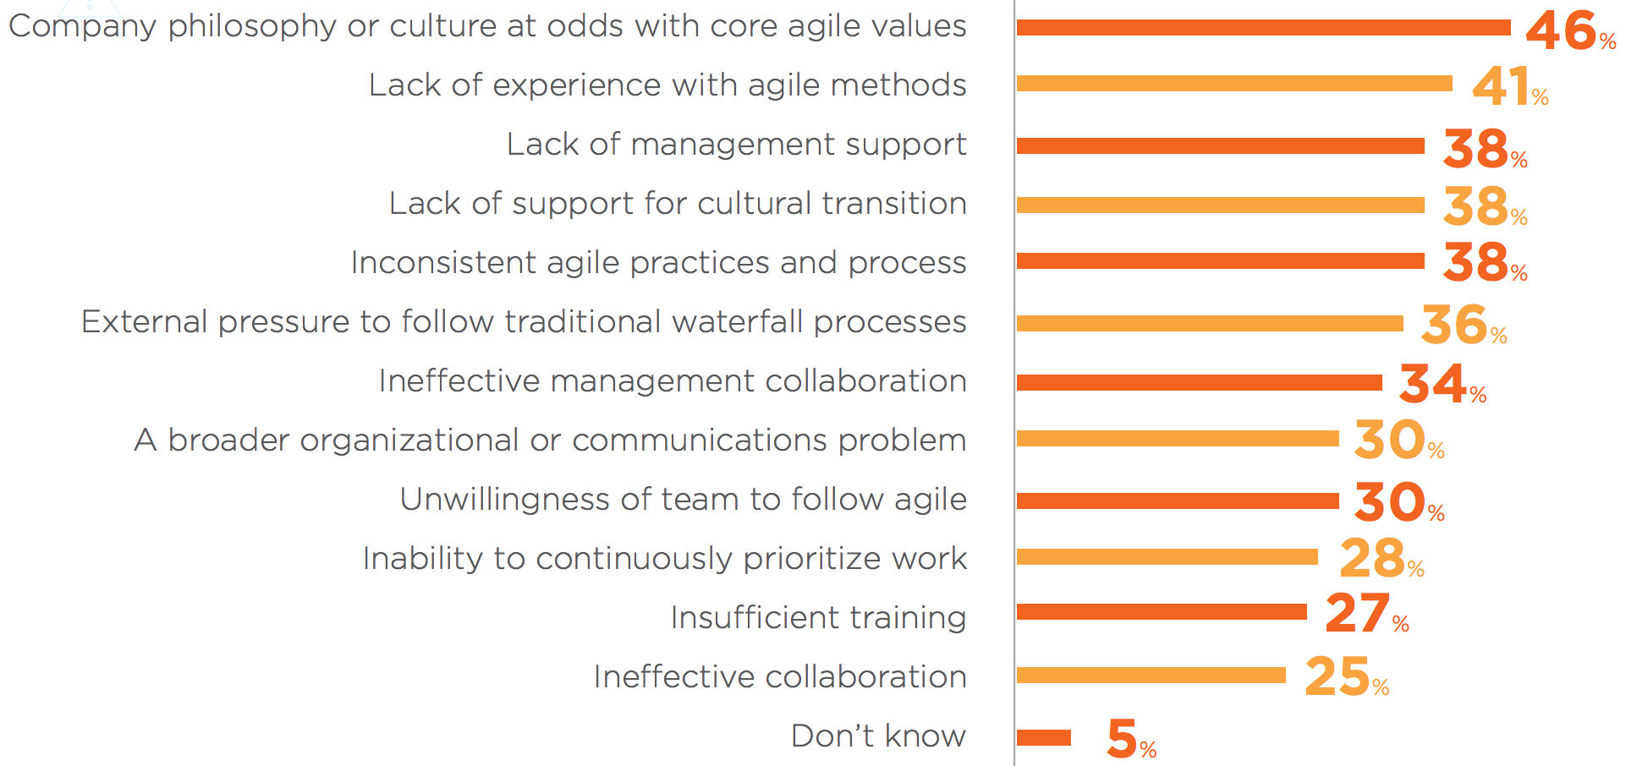
Why Agile Fails?
Pick at least one & discuss as a team.
Share team feedback.
2015 State of Agile Survey
10 min

Slide 11
Agile Values & Principles

Slide 12
Agile is a Generic Term
Scrum
SAFe
xScale
Kanban
XP
LeSS
Spotify
LeSS Huge
Crystal
DAD
Nexus

Slide 15
What gets in the way?
Matrixed Organizations
Non-instantly Available Resources
Too Much Work In Process
Limited Access to Subject Matter Expertise
Team
Large Products with Diverse Technology
Shared Requirements Between Teams
Technical Debt & Defects
Low Cohesion &
Tight Coupling
Notes:
Matrixed management
Non-instantly available resources
Project funding models
Limited access to subject matter expertise
Shared requirements between teams
Technical debt
Defects
Tightly coupled architectures

Slide 16
Why the focus on principles?
A common disease that afflicts management the world over is the impression that, “Our problems are different." They are different to be sure, but the principles that will help to improve quality of product and service are universal in nature.
—W. Edwards Deming
Notes:
Trainer Guidance:
ASK: “Why do we have this slide?” A: We showed up at one company and they had a Scrum Team composed of 32 Requirements Analysts! That Scrum Team was talking to a Scrum Team of 32 developers. Obviously, there’s no such principle supporting that type of organizational structure.
ASK: “So why principles?” A: Because every implementation is different. Principles make sure we’re moving in the right direction as we account for the differences. The principles give us something to check against.
ASK:” Would you support a 1-week Iteration?” A: Yes. Why? Because some of these principles support it (point out which ones).
ASK: “Now, would you support a 1-month Iteration?” A: No, because there’s nothing in the principles that supports it.
Tips:
Building enterprise-class software and cyber-physical systems are some of the most complex challenges our industry faces today. For example:
It requires millions of lines of software.
It combines complex hardware and software interactions.
It crosses multiple concurrent platforms.
It must satisfy demanding and unforgiving Nonfunctional Requirements (NFRs).
And, of course, the enterprises that build these systems are also increasingly sophisticated. They are bigger and more distributed than ever. Mergers and acquisitions, distributed multinational (and multilingual) development, offshoring, and rapid growth are all part of the solution. But they’re also part of the problem.
References:
Read more at: http://www.scaledagileframework.com/safe-lean-agile-principles/

Slide 17
Agile Manifesto: Value Statements
We are uncovering better ways of developing software by doing it and helping others do it. Through this work we have come to value:
Individuals & interactions
over
Processes & tools
Working software
over
Comprehensive documentation
Customer collaboration
over
Contract negotiation
Responding to change
over
Following a plan
That is, while there is value in the items on the right,
we value the items on the left more.
Source: www.agilemanifesto.org
Notes:
Predictability
Quality
ROI, time to market
Clearly defined roles and responsibilities
What to expect –
Greater transparency
Misalignments and dysfunctions become more visible
Conflicting metrics (the way things are measured, what is measured, and what they mean)
It’s important to address these

Slide 18
Principles of AgileManifesto.org
Our highest priority is to satisfy the customer through early and continuous delivery of valuable software.
Welcome changing requirements, even late in development. Agile processes harness change for the customer's competitive advantage
Deliver working [product] frequently, from a couple of weeks to a couple of months, with a preference to the shorter timescale.
Business people and developers must work together daily throughout the project.
Build projects around motivated individuals. Give them the environment and support they need, and trust them to get the job done.
The most efficient and effective method of conveying information to and within a development team is face-to-face conversation.
Notes:
<idea: draw the sailboat now and have people do that exercise as we talk through these principles: benefits of following, problems if not followed>

Slide 19
Principles of AgileManifesto.org (con’t)
Working [product] is the primary measure of progress.
Agile processes promote sustainable development. The sponsors, developers, and users should be able to maintain a constant pace indefinitely.
Continuous attention to technical excellence and good design enhances agility.
Simplicity--the art of maximizing the amount of work not done--is essential.
The best architectures, requirements, and designs emerge from self-organizing teams.
At regular intervals, the team reflects on how to become more effective, then tunes and adjusts its behavior accordingly.

Slide 20
Key Principles to Emphasize in Execution
Deliver Incremental value and get fast feedback cycles
Stop starting, start finishing – Limit Context Switching
Optimize the whole system, not just your part
Reduce Batch Sizes
Apply Cadence and Synchronization
Decentralize Decision Making

Slide 21
Deliver Iteratively and get Fast Feedback Cycles
Iterative
Big bang
Courtesy of Jeff Patton
Notes:
(AF: The problem with this slide as presented in prior versions of the deck is that it doesn’t make clear how to put iterative and incremental together at all, and especially not in time. We iterate first to make an increment that we can ship. Then we iterate to build additional increments.)

Slide 22
Deliver value incrementally
Fast feedback
Waterfall
Value delivery
Incremental
Time
Notes:
Key Message:
The prime directive of Agile development is to deliver value early, to the customer if we can, or for internal feedback if we can’t.

Slide 23
Scope
Cost
Time
Notes:
We do all this work analyzing and planning the scope,
Then management comes and says cut cost in half and cut time in half
So lots of that analysis is waste.
Made worse in that needs of customer often arise faster than we can deliver.
That’s the problem with the predictive approach. We are in a knowledge creation activity that can’t be predicted in the way that many try.
So, scope is most often not the primary constraint for sw.
There is most often the need to get something to market quickly.
Is that true here?
If not, are you sure? Is there value in feedback?
There is value in getting revenue / payback for your investment sooner.

Slide 24
Key Principles to Emphasize in Execution
Deliver Incremental value and get fast feedback cycles
Limit Context Switching
Optimize the whole system, not just your part
Reduce Batch Sizes
Apply Cadence and Synchronization
Decentralize Decision Making

Slide 25
Let’s do a quick exercise

Slide 27
Key Principles to Emphasize in Execution
Deliver Incremental value and get fast feedback cycles
Limit Context Switching
Optimize the whole system, not just your part
Reduce Batch Sizes
Apply Cadence and Synchronization
Decentralize Decision Making

Slide 29
Key Principles to Emphasize in Execution
Deliver Incremental value and get fast feedback cycles
Limit Context Switching
Optimize the whole system, not just your part
Reduce Batch Sizes
Apply Cadence and Synchronization
Decentralize Decision Making

Slide 30
Let’s do a quick exercise

Slide 31
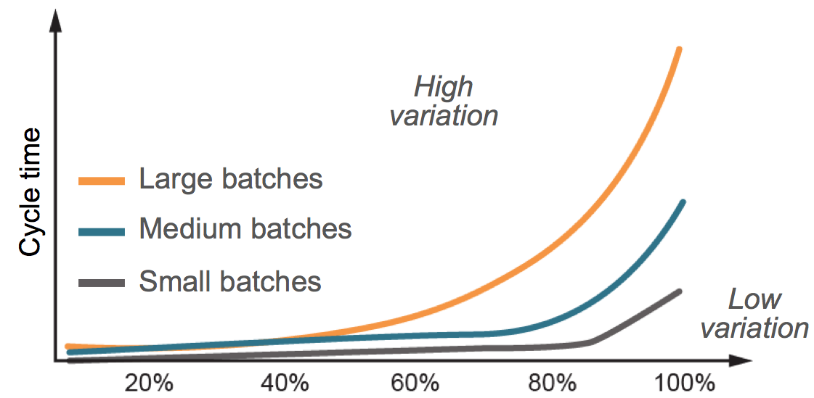
Reduce batch size for higher predictability
Implementing Lean Software Development, Poppendieck, Mary.

Slide 32
Finding the Optimum Batch Size
Optimum batch size
(lowest total cost)
Total cost
Cost
Transaction cost
Holding cost
Items per batch
Principles of Product Development Flow, Don Reinertsen
Notes:
Trainer Guidance:
Lean is not black and white. There is a connection between the transaction and holding costs. You can see how the transaction cost changes by the size of the batch.
The more items I transfer at once, the lower the overall transaction cost is. On the other hand, the more items I have in a batch, the larger my inventories are, which increases the holding cost.
The optimal batch size is at the minimum of the aggregation of the transaction and holding costs. The aggregated values form a U-Curve, and it’s not an exact science, rather, a sweet spot.
Tips:
U-Curve illustrates the number of batch sizes.
U-Curve Optimization is a common effect in Lean, it highlights trade-offs which vary by context. Must understand transaction and holding costs.
Applies to collocation since there are greater holding costs due to batching and lower transaction costs. Want the intersection.
Applies to Iteration length, number of stories in a Iteration, number of Features in a PI, amount of code developed before check.

Slide 33
Key Principles to Emphasize in Execution
Deliver Incremental value and get fast feedback cycles
Limit Context Switching
Optimize the whole system, not just your part
Reduce Batch Sizes
Apply Cadence and Synchronization
Decentralize Decision Making

Slide 34
Cadence and synchronization
Cadence
Synchronization
Converts unpredictable events into predictable ones and lowers cost
Makes waiting times for new work predictable
Supports regular planning and cross-functional coordination
Limits batch sizes to a single interval
Controls injection of new work
Provides scheduled integration points
Causes multiple events to happen at the same time
Facilitates cross-functional tradeoffs
Provides routine dependency management
Supports full system and integration and assessment
Provides multiple feedback perspectives
Principles of Product Development Flow, Don Reinertsen
The Lean Machine, Dantar Ootserwall
Notes:
Trainer Guidance:
ASK: “What’s an example of an unpredictable event that’s now predictable in SAFe?” A: Collect answers from the team.
If you asked CEO’s, “You can take one pill for productivity or one for predictability. Which would you take?" They will always answer “Predictability”.
Delivering on cadence requires reserve capacity.
Synchronization causes multiple events to happen at the same time.
ASK: “Did you ever have a plan where you didn't have to adjust the plan to actual?”
Cadence provides a rhythmic pattern, the dependable heartbeat of the process. It makes routine that which can be routine, so the intellectual capacity of knowledge workers can be devoted to managing the variables. By transforming unpredictable events into expected events, cadence offers many additional benefits.
Synchronization allows multiple perspectives to be understood, resolved, and integrated at the same time. As a result, it:
Pulls the different assets of a system together to assess solution viability.
Aligns the development teams and business to a common mission.
Integrates the customers into the development process.
References:
Read more at: http://www.scaledagileframework.com/apply-cadence-synchronize-with-cross-domain-planning/

Slide 35
Cadence without synchronization is not enough
Time spent thinking you are on track
When you discover you are not
System
Integrate and slip!
Iterate
Iterate
Iterate
Iterate
Iterate
Iterate
Iterate
Iterate
Iterate
Iterate
Iterate
Iterate
Iterate
Iterate
Iterate
Iterate
Iterate
Iterate
Iterate
Iterate
Iterate
Iterate
The slowest component drags the program, still late discovery!
Notes:
Trainer Guidance:
ASK: “Why cadence matters?”
A: Predictability! Predictability is critical!
In bottom up implementations, we’ve learned people start iterating.
Tie back to manifesto and point out ‘Adopt systems thinking.’
THE PROBLEM: We need to improve as a whole, not as a team. Thus we can’t improve without seeing the the bigger picture.
NOTE: PI time boxes can vary in size. The exact duration is less important than picking a duration and sticking with it. Keep the time boxes aligned and consistent.

Slide 36
Synchronize to assure delivery
This system IS sprinting
Notes:
Trainer Guidance:
The system needs to iterate, not just teams.
Emphasize that in this picture, the system is sprinting, not just the teams!
This is not assumption driven development. You have to integrate with everyone else to know you are there.
Components are (typically) not something you are selling. Your customer has no idea the components exists. But if a component enables value, then it needs to sprint at on the same cadence as the system.

Slide 37
Key Principles to Emphasize in Execution
Deliver Incremental value and get fast feedback cycles
Limit Context Switching
Optimize the whole system, not just your part
Reduce Batch Sizes
Apply Cadence and Synchronization
Decentralize Decision Making

Slide 38
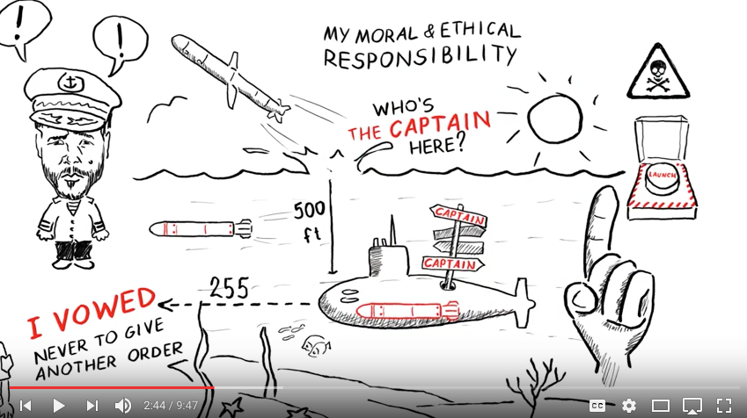
Decentralize decision-making
Centralize
De-centralize everything else
Infrequent - Not made very often and usually not urgent (ex: internationalization strategy)
Long-lasting - Once made, highly unlikely to change (ex: common technology platform)
Significant economies of scale - Provides large and broad economic benefit (ex: compensation strategy)
Frequent - Routine, everyday decisions (ex: Team and Program Backlog)
Time critical - High cost of delay (ex: point release to customer)
Require local information - Specific and local technology or customer context is required (ex: Feature criteria)
Inno-Versity Presents: "Greatness" by David Marquet https://youtu.be/OqmdLcyES_Q 9:47

