Slide 1
Team Dynamics

Slide 2
What are characteristics of a great team you’ve been on?
Notes:
Create well-formed teams that stay together. Bring work to the team.
Keep a team together and feed it a continuous stream of work.
If you do that, they will develop a culture and norms,
Will know each others strengths and weaknesses
The team will begin to gel.
They’ll be efficient and predictable.

Slide 3
The power of “ba”
We, the work, and the knowledge are all one
Dynamic interaction of individuals and organization in the form of a self-organizing team, the fuel of “ba” is its self-organizing nature
Team members create new points of view and resolve contradictions through dialogue
“Ba” is energized with intentions, vision, interest, and mission
Leaders provide autonomy, variety, trust, and commitment
Creative chaos via demanding performance goals
The team is challenged to question every norm of development
Equal access to information at all levels is critical
Nishida, 1921, 1970 Hitotsubashi on Knowledge Management, Takeuchi and Nonaka. 2004
Notes:
Ba theory:
Ba is a Zen-like energy of a self organizing team.
Ba theory is an idea existing from ancient times in the Eastern world, and its characteristics are reflected in Buddhism and Japanese philosophy. In short, it can be characterized by the idea of non-separation of subject and object, and non-separation of the self and the other. My translation ”we, the work, and the knowledge are all one”.
Selectively read just a few of these bullets, but let the class take the time to read the entire slide.
Ba is a critical concept in building high performing of cross, functional teams. Jeff Sutherland refers to his studies on knowledge management and ba as part of the roots of Scrum.
ba is enhanced by colocation. Some descriptions speak of ba as the energy that emerges in the physical meeting space. That said, virtual location ba is is also noted in the research.

Slide 4
Trust is the Foundation of a Great Team
Focus on delivering
Measurable Results
collective & individual accountability
feedback
Inattention to RESULTS
Avoidance of ACCOUNTABILITY
Lack of COMMITMENT
Fear of CONFLICT
Absence of TRUST
The Five Dysfunctions of a Team
- Patrick Lencioni
Status and Ego
To take Accountability
Requires prior Commitment
- 100% buy-in
Low Standards
Commitment follows healthy Conflict
- Hear all -> Disagree -> Decision -> Buy-in -> One Voice
Ambiguity
Healthy Conflict implies Candid Debate
- Trust to speak opinion without fear of retribution
Artificial Harmony
Building Trust requires Vulnerability - Courage to risk
Invulnerability
Notes:
Activity:
1 Flipchart paper for each layer
Green & Red Zones for each behavior – 3 stickies each
What would a ScrumMaster do to influence behavior from Red to Green?
(Could be baseline for a working agreement)

Slide 5
Team Maturity Stages
Forming
Getting to Know You Stage
Storming
‘Me’ Thinking Stage
Norming
‘We’ Thinking Stage
Performing
‘Efficient Processes’ Stage
Notes:
Forming – Getting to Know You: In the Forming stage, team members are getting to know one another and getting comfortable with one another. Members will naturally try to understand their own roles, the roles of the other team members and their purpose in the group. This is entirely natural and to be expected. People are unsure, suspicious and nervous. Formation of the team happens Team members are anxious highly depending on the manager/leader
Leadership Style: Directing – provide clarity on role, common purpose/vision, desired goals, cultural norms, boundaries and constraints …etc
Storming – High Winds Expected: Storming is the most difficult stage for a team to weather, but it is necessary for healthy team development. When team members begin to trust one another enough to air differences, this signals readiness to work things out. Debates on how to execute tasks
Need clarity on priorities, purpose and responsibilities
Look for processes to follow
Power struggles may arise
Team members may challenge the leader
Leadership style: Selling
Norming – Charting a Course: When teams recognize their differences and have dealt with them, they move to Norming, the stage when they ask, "How are we going to accomplish our work?" Beyond the politeness and nervousness of Forming and past the issues and concerns of Storming, teams will want to review how they are functioning. Work as a team starts
Roles and responsibilities are agreed upon
Decision making happens by group consensus Commitment, trust and unity increases
Leadership style: Supporting
Performing – Action Stage: Performing teams are just that, a highly effective, problem-solving unit that can reach solutions quickly and can even head off issues before they become problems. High interpersonal relations
High independence, motivation
Team know why & how about the tasks
High level of respect in communication Leadership style: Delegating
Reference: http://tinyurl.com/l7qghr

Slide 6
Team Environment – Communication Effectiveness
Notes:
Show conference call YouTube video.

Slide 7
Working Agreement
Commitment
Focus
Respect
Courage
Openness
Agile
Notes:
[Need to pick 1 of 2 next slides… thoughts?]

Slide 8
Self Organization
Within established boundaries
Within the constraints of the organizational policies
Business decides what
Team decides how and how long
Swarming
Notes:
Day 1 – Lunch Break
Self-organized != Self-directed

Slide 9
Agile Leadership

Slide 10
Industrial Work vs. Knowledge Work
Industrial Work | Knowledge Work
Work is stable | Work is changing
Emphasis on running things | Emphasis on changing things
More structure with fewer decisions | Less structure with more decisions
Focus on right answers | Focus on right questions
Command and Control | Give Autonomy
Strict Standards | Continuous Innovation
Minimize cost of workers for a task | Treat workers as assets, not as costs

Slide 11
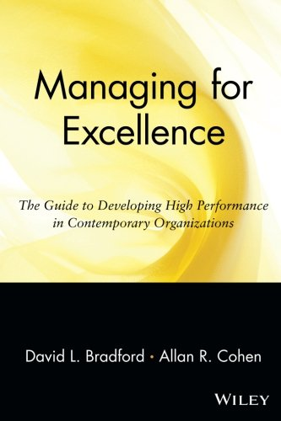
Leadership styles
The effectiveness of your workers is determined in large part by your personal leadership style.
Leader as expert
Leader as conductor
Leader as developer
Recommended Reading: Managing for Excellence, David Bradford and Allan Cohen
Notes:
In this suggested reading, the authors take an on objective, non-pejorative view of the different management styles. Let’ s look at some of the differences between Leaders as: Expert, Conductor and Developer

Slide 12
Leader as expert
Can be effective when manager has greater knowledge than direct reports
Characteristics
Technician or master craftsman
Promoted because they were the best at their job
Problem solver, the one people go to for answers
Understands the domain and the technology
Work is when people leave them alone
Challenges
Limits learning and growth of direct reports
Focus on technical problems to the detriment of human factors
Managing for Excellence, David Bradford and Allan Cohen
Notes:
ASK: All things being equal, would you want someone who was your boss to have the same domain knowledge as you?
A: Chances are “yes”. But the catch is “all things are not always equal.” Sometimes a domain knowledge skill set doesn’t always equate to management skills.
EXAMPLE: The Dilbert “Knack” video

Slide 13
Leader as conductor
Can be effective when coordination is a prerequisite for maximum performance
Characteristics
The central decision maker, nerve center, coordinator
Orchestrates all individual parts of the organization into a harmonious whole
Subtle and indirect manipulation to their solution
Manages across individuals, teams, and departments
Work is coordinating others
Challenges
Narrows the focus of direct reports to their own areas
Conflict tends to push upward looking for the boss to fix
Use systems and procedures to control work
Works harder and harder, without realizing full potential
Managing for Excellence, David Bradford and Allan Cohen
Notes:
Can be especially effective in big organizations that are political (Remember of course, not all big organizations are political.)
Work then is co-coordinating others, don’t take the problems on yourself.

Slide 14
Good leader myth responsibility trap
Leader feels over-responsible
Negative reinforcing cycle
Fails to make full use of the knowledge and competencies of direct reports
Produces narrow and self-interested direct reports
for coordination
for answers
for overall unit goals
direct reports feel overcontrolled
direct reports feel blocked, underused
direct reports feel committed only to own subgoals
Direct reports feel lower commitment and sense of responsibility
Managing for Excellence, David Bradford and Allan Cohen

Slide 15
Leader as developer of people
Escape the trap with a post-heroic, lean leadership style
Behaviors
Creates a team jointly responsible for success
Asks, “How can each problem be solved in a way that further develops my people’s commitment and capabilities?”
Work is developing other’s abilities
Benefits
Increased direct report ownership and responsibility
Increased employee engagement and motivation
Allows leader to spend more time managing laterally and upward
There is no limit to the power of getting things done
Notes:
This is the “Servant Leader”. Their approach is epitomized by the: “How can each problem be solved in a way that further develops my people’s commitment and capabilities?”
Servant Leaders don’t take credit for successes, but rather deflect the praise to the team.
Servant Leaders show empathy when things go wrong. Example: If a release gets blown, their reaction isn’t to point fingers or find blame, but rather, a SL asks, “What did we learn?”.
Servant Leaders don’t grow people as much, but lets them grow themselves. They allow team members to step up.
ASK: Now, will all people step up given this environment?
A: Of not not everyone. Some will just want to me directed. There’s nothing you can do about them. But most people will step up.

Slide 16
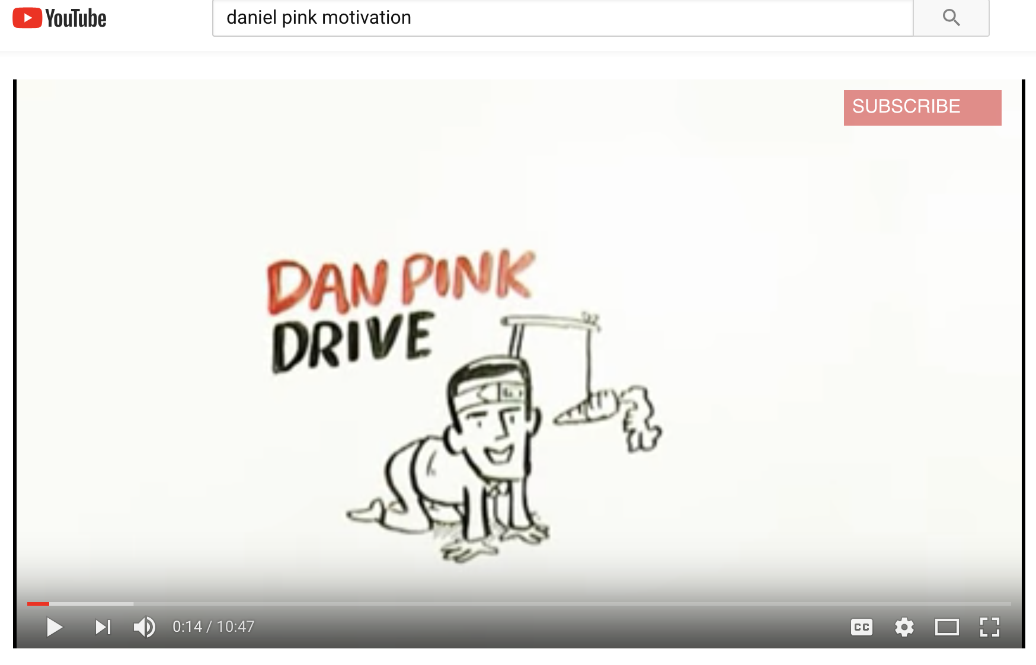
https://www.youtube.com/watch?v=u6XAPnuFjJc

