Slide 1
Notes:
https://www.sharilevitin.com/blog-news/sales-presentations/ask-more-questions/
https://www.inc.com/lee-colan/4-questions-great-leaders-ask.html

Slide 2
Spotify model

Slide 3
To be clear, we never coined the expression “Spotify Model”; we have just been talking to people about what we’re currently doing.
Joakim Sundén
Team and Leadership Coach at Spotify
Notes:
https://www.infoq.com/news/2017/10/spotify-agile-nirvana

Slide 4
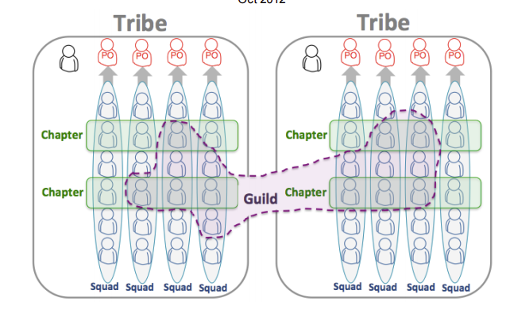
https://blog.crisp.se/wp-content/uploads/2012/11/SpotifyScaling.pdf
Notes:
Jurate

Slide 5
Squad
A “mini startup” responsible a long term mission (Ex. Build and improve android client)
Has all the skills to develop and push to prod
Self organizing and could chose scrum, kanban, etc
Has access to an agile coach
Notes:
Jurate

Slide 6
Tribe
A collection of squads that work in a related area (ex. Music player)
100 ppl or less
Has a tribe leader who creates healthy environment
Notes:
Jurate

Slide 7
Chapter
A small group of people with similar skills working in the same tribe
Chapter lead is usually the HR manager
Notes:
Jurate

Slide 8
Guild
Organic wide reaching community of interest (ex: Tester guild, agile coach guild)
Can exist across tribes
Has a “guild coordinator”
Notes:
Jurate

