Slide 1
Notes:
https://www.sharilevitin.com/blog-news/sales-presentations/ask-more-questions/
https://www.inc.com/lee-colan/4-questions-great-leaders-ask.html

Slide 2
Forming a New Team

Slide 3
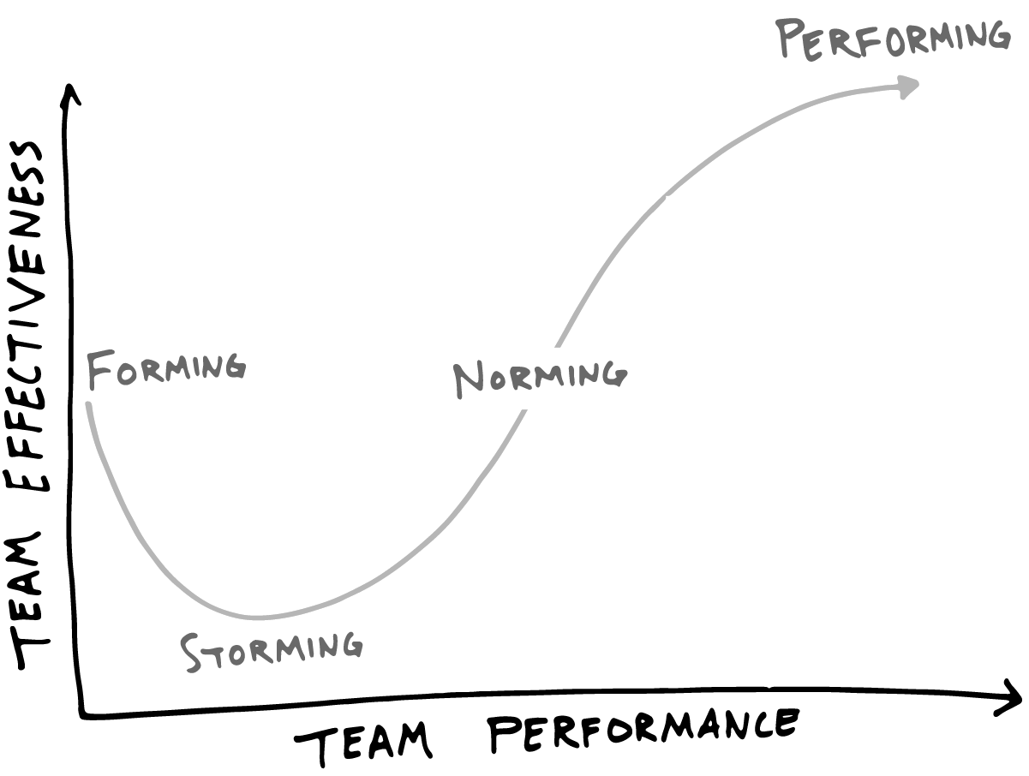

Slide 4
Make things really clear
Working Agreements
Definition of Ready
Definition of Done
Notes:
Jurate

Slide 5
Working Agreements
Working agreements help establish a team culture. They exist to help a self organizing team establish behavioral standards on how they work together without having them imposed externally.
Notes:
Time and location of Daily Scrum
Testing strategy (unit, functional, integration, performance, stress, etc…)
Build and infrastructure plans (shared responsbilities)
Team norms (be on time, respect estimates, help when needed, etc…)
How to address bugs/fires during Sprint
Product Owner availability (phone, office hours, attendance in Daily Scrum)
Expectations of each role and how they will work together at each phase of the SDLC

Slide 6
Area’s to consider
What’s most important to the team’s culture?
Mtg Times/Location
Meeting behaviors (on time, video on, etc)
Roles
Define Communication Channels
Response Expectations
How to address fire drills or other urgent situations
Notes:
Time and location of Daily Scrum
Testing strategy (unit, functional, integration, performance, stress, etc…)
Build and infrastructure plans (shared responsbilities)
Team norms (be on time, respect estimates, help when needed, etc…)
How to address bugs/fires during Sprint
Product Owner availability (phone, office hours, attendance in Daily Scrum)
Expectations of each role and how they will work together at each phase of the SDLC

Slide 7
Example Discussion
What do we need to communicate to each other?
In order of preference what tools do we use to communicate?
When we communicate we expect a response within :
We will know what stories are worked on by:
We will aim to work during these hours:
We will provide each other feedback by:
https://blog.lucidmeetings.com/blog/remote-team-working-agreement-example
Notes:
https://blog.lucidmeetings.com/blog/remote-team-working-agreement-example
The Happy Melly Working Agreement
Each team has its own unique way of communicating and a particular combination of personality types. And just like an orchestra tunes up before a performance, or an athlete warms up before a practice, tuning a virtual team helps get everyone on the same page so we can do great things together.
Information
Shared wiki explains processes, philosophy, and rules(public)
Files & docs are stored in Google Drive (team only access)
Communication
We talk in the CET time zone
Team meeting: Thursday 4pm in Zoom (topics in Trello)
Ongoing virtual coffees: Mondays at 10:00 CET
We update each other with iDoneThis based on commitment level (CL3 = update 3 times per week)
Ongoing communication is done in Slack (team chat)
Short term things go into Trello
Response time? (Slack is main platform)
Level 3 or 4: 24 hour response
Level 2: 48 hour response
Let us know when you’re not unusually around #random
Don’t assume people are online when you see their status as active
Meetings:
Agenda topics get added to Trello
Ongoing conversation in # hmo_meetings
When you can’t hear someone, make the Workout gesture!
Collaboration
Each team has a Product Owner of a Trello board. That PO decides what goes into the Prioritized column and decides the priority.
When you add things, add to Ideas column (not Prioritized) - or face the wrath of the PO
Add and remove yourself from the cards you are working on regularly
When we are waiting on something, add it to the Waiting column
If something is broken, you don’t have to wait for the PO to move a card into Prioritized and Planned
We submit peer feedback each month - can be during the month or at the end - your choice (using the Merit Money system and Bonus.ly)
It is not mandatory to participate in the merit money system. However you may not receive merit money from your colleagues if you do not give merit money to your colleagues.
Regular reviews of team agreement and retrospectives

Slide 8
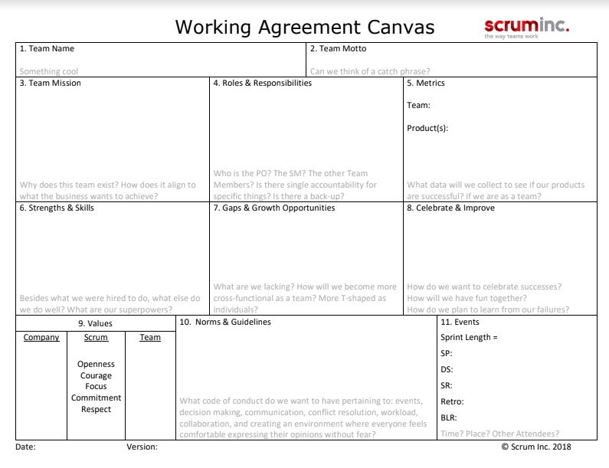
Since canvas’s are all the rage now…
https://www.scruminc.com/team-working-agreement-canvas/
Notes:
https://www.scruminc.com/team-working-agreement-canvas/

Slide 9
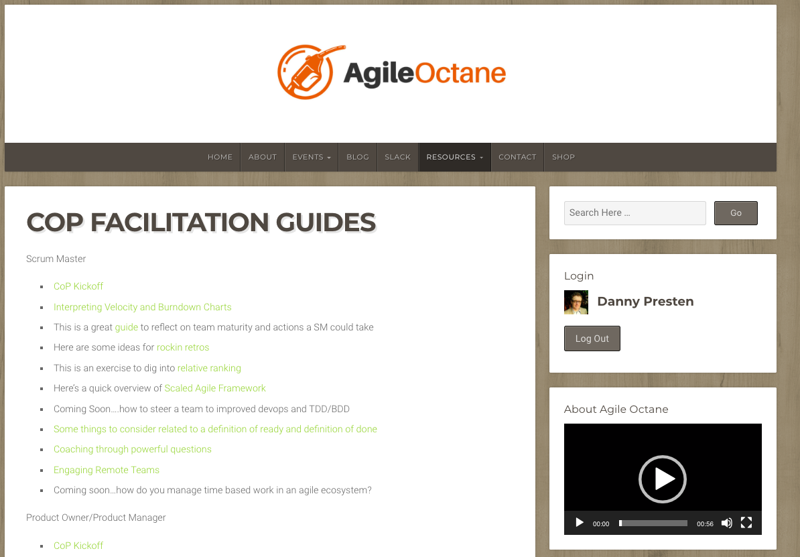
Check out this for more on definition of ready and definition of done
https://www.agileoctane.com/wp-content/uploads/2018/07/Agile-Octane-Definition-Ready-Done.pptx

