Slide 1
Notes:
https://www.sharilevitin.com/blog-news/sales-presentations/ask-more-questions/
https://www.inc.com/lee-colan/4-questions-great-leaders-ask.html

Slide 2
Engaging Remote Teams

Slide 3
From the Agile Manifesto
The most efficient and effective method of conveying information to and within a development team is face-to-face conversation.
this is often impossible in today’s world
Notes:
Jurate

Slide 4
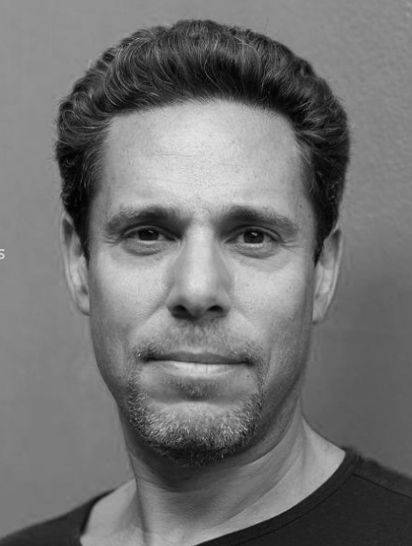
“Being able to choose where and when we work empowers us to be more productive, more engaged, and more balanced in every aspect of our lives. After 14 years as a fully remote company, we’re convinced a distributed environment isn’t just good for our employees. It’s also one of the key reasons we’ve been so successful as a company.”
-Adam Schwartz CEO Articulate

Slide 5
Why do you invite people to meetings?

Slide 6
Communication Effectiveness
Notes:
Show conference call YouTube video.

Slide 7
What challenges do you deal with in meetings?
Conference Calls
Video Calls
Mixed Medium
Multi - Culture
Face to face
Various Agile Maturity Levels
Notes:
Timezones people from all over the world
Mute button – silence or background noise
No ability to see each other so people get cut off and talked over
Multi tasking or people not paying attention
Miscommunication due to non verbals
No good video tool, something about webex
Hard to hear what’s going on with everyone
Use different mediums
Different understanding of Agile processes
Cultural differences
Drawing people into conversation…they don’t speak up
Lack of working agreements

Slide 8
Principle
The best engagement occurs when the group is on the same platform

Slide 9
Principle
Higher resolution communication is more efficient communication

Slide 10
Principle
“Nobody cares how much you know, until they know how much you care.”
–Theodore Roosevelt
Notes:
This is critical…if you truly care about your team and want to help them often the technical side of all of this just naturally falls into place. Make it your goal to honestly want to do what’s best for each individual and you’ll be on the right trajectory. If you’re biggest concern if just getting stuff done then the team will always struggle to become a truly high performing team that exceeds expectations.

Slide 11
Tangible Tips to Experiment with
Start to spread leading practices across this group
Travel to get everyone together at least once
Stop using outdated tools – free doesn’t always mean good
Get approval for trying new tools
Try out a tool and get familiar with it before using it with the team
Virtual hand raising
Show pictures
Keep a chat going while mtg is in process
Use open ended questions to encourage conversation “What do you think about…”
Make sure everyone has a chance to talk and no one person dominates discussion
Setup recurring 1:1 time with each team member
Say “I trust what you’re saying” then state the challenge
Share something personal…hobbies, the fact you had a baby yesterday, etc.

