Slide 1
Demystifying SAFe

Slide 2
Introductions…
Notes:
How much do you know about agile?
What is your role?

Slide 3
What have you heard about SAFe?

Slide 4
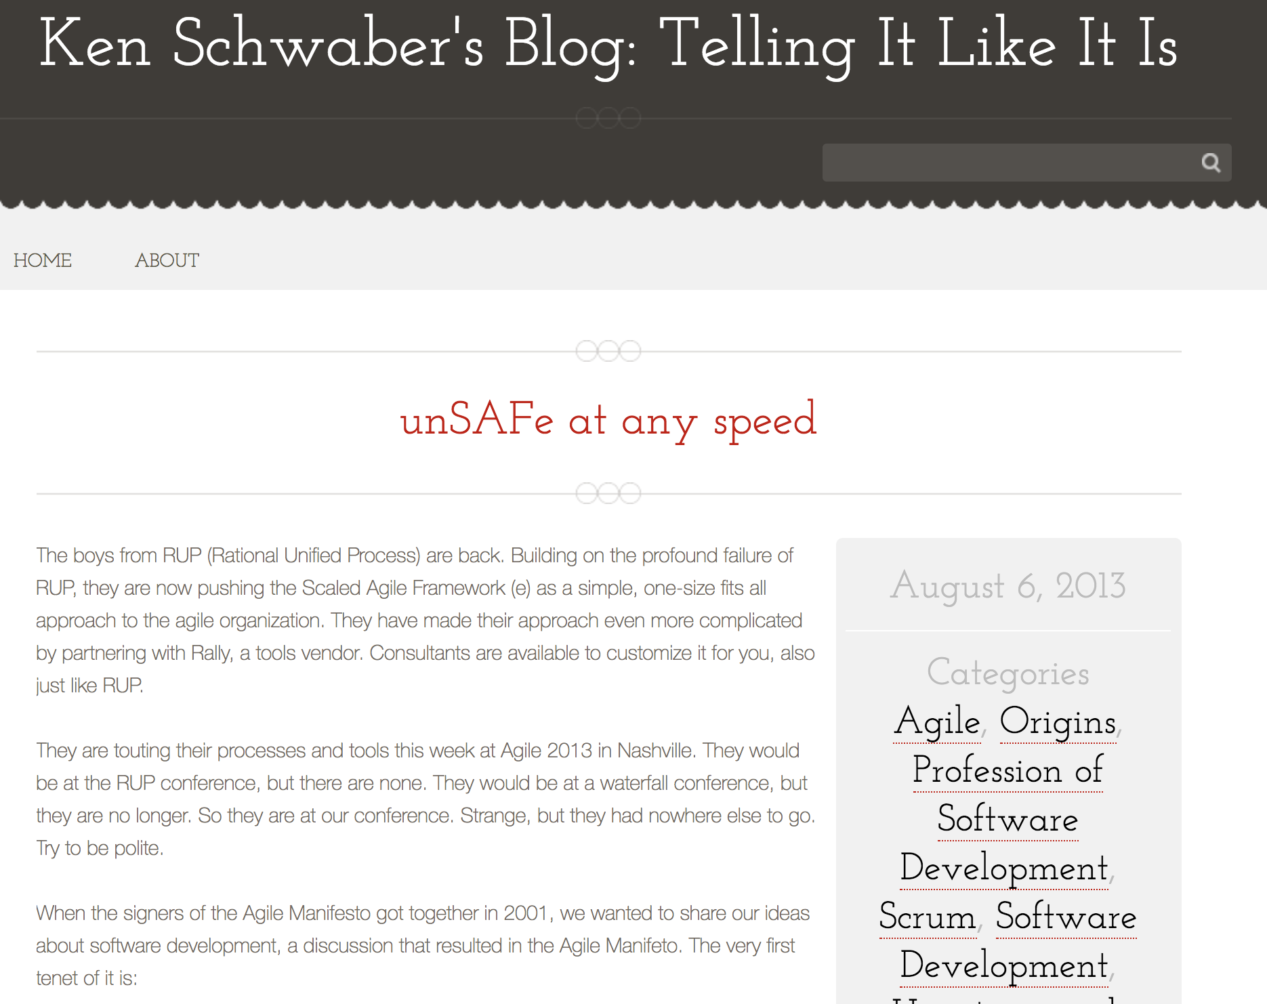
”The boys from RUP (Rational Unified Process) are back. Building on the profound failure of RUP, they are now pushing the Scaled Agile Framework (e) as a simple, one-size fits all approach to the agile organization.
They are touting their processes and tools this week at Agile 2013 in Nashville. They would be at the RUP conference, but there are none. They would be at a waterfall conference, but they are no longer. So they are at our conference. Strange, but they had nowhere else to go. Try to be polite.”

Slide 5
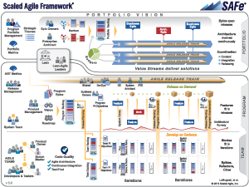
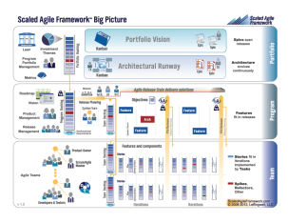
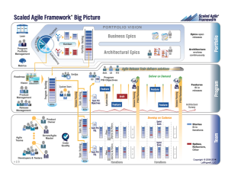
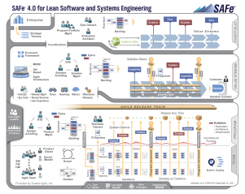
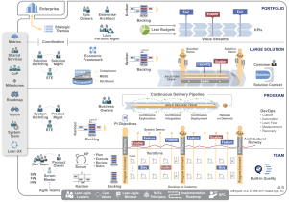
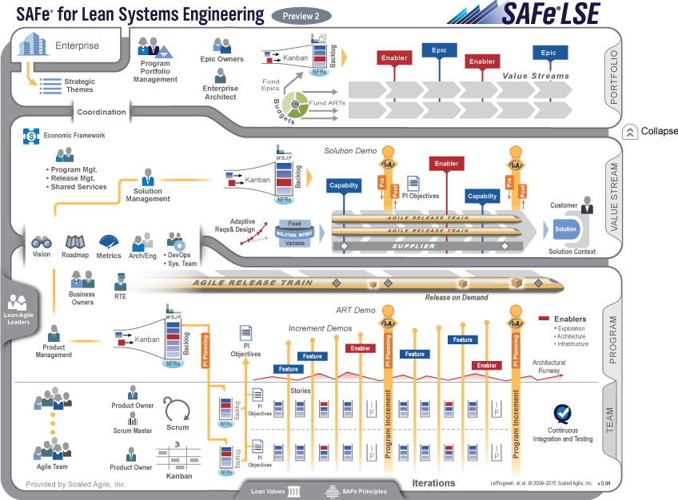
Roots, past, present and future
Field experience at enterprise scale
2011
Now…
3.0
4.0
4.5
1.0
2.0
LSE
Agile development | Lean product development | Systems thinking
Notes:
The Framework is based on a huge body of knowledge – Lean Thinking, Lean Product Development, Systems Engineering and Agile to name a few.
The knowledge of the Framework isn’t a one time learning event. It’s an on-going process.
The Framework is constantly being updated to stay current. Previously we’d release more frequent updates. Now there is once a year release cycle on the “Big Picture” .
Pace of innovation still remaining constant, we are still continually updating with what we learn. We’ve just slowed down the updates of the UI only (is updated annually)

Slide 6
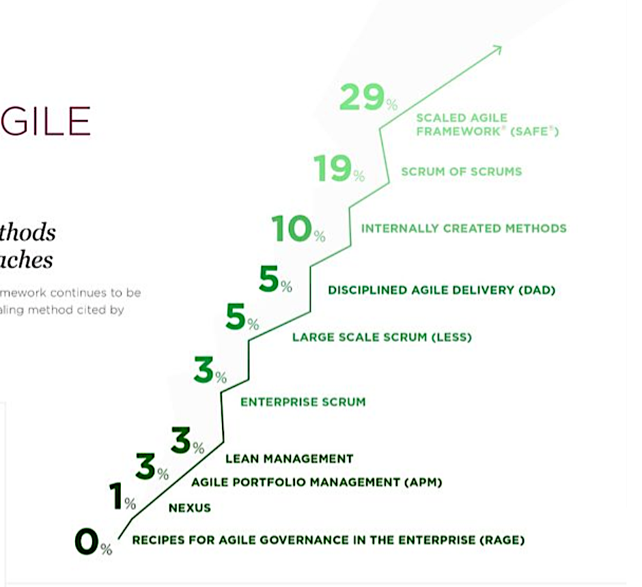
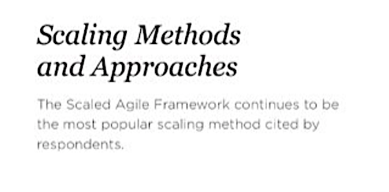

Slide 7
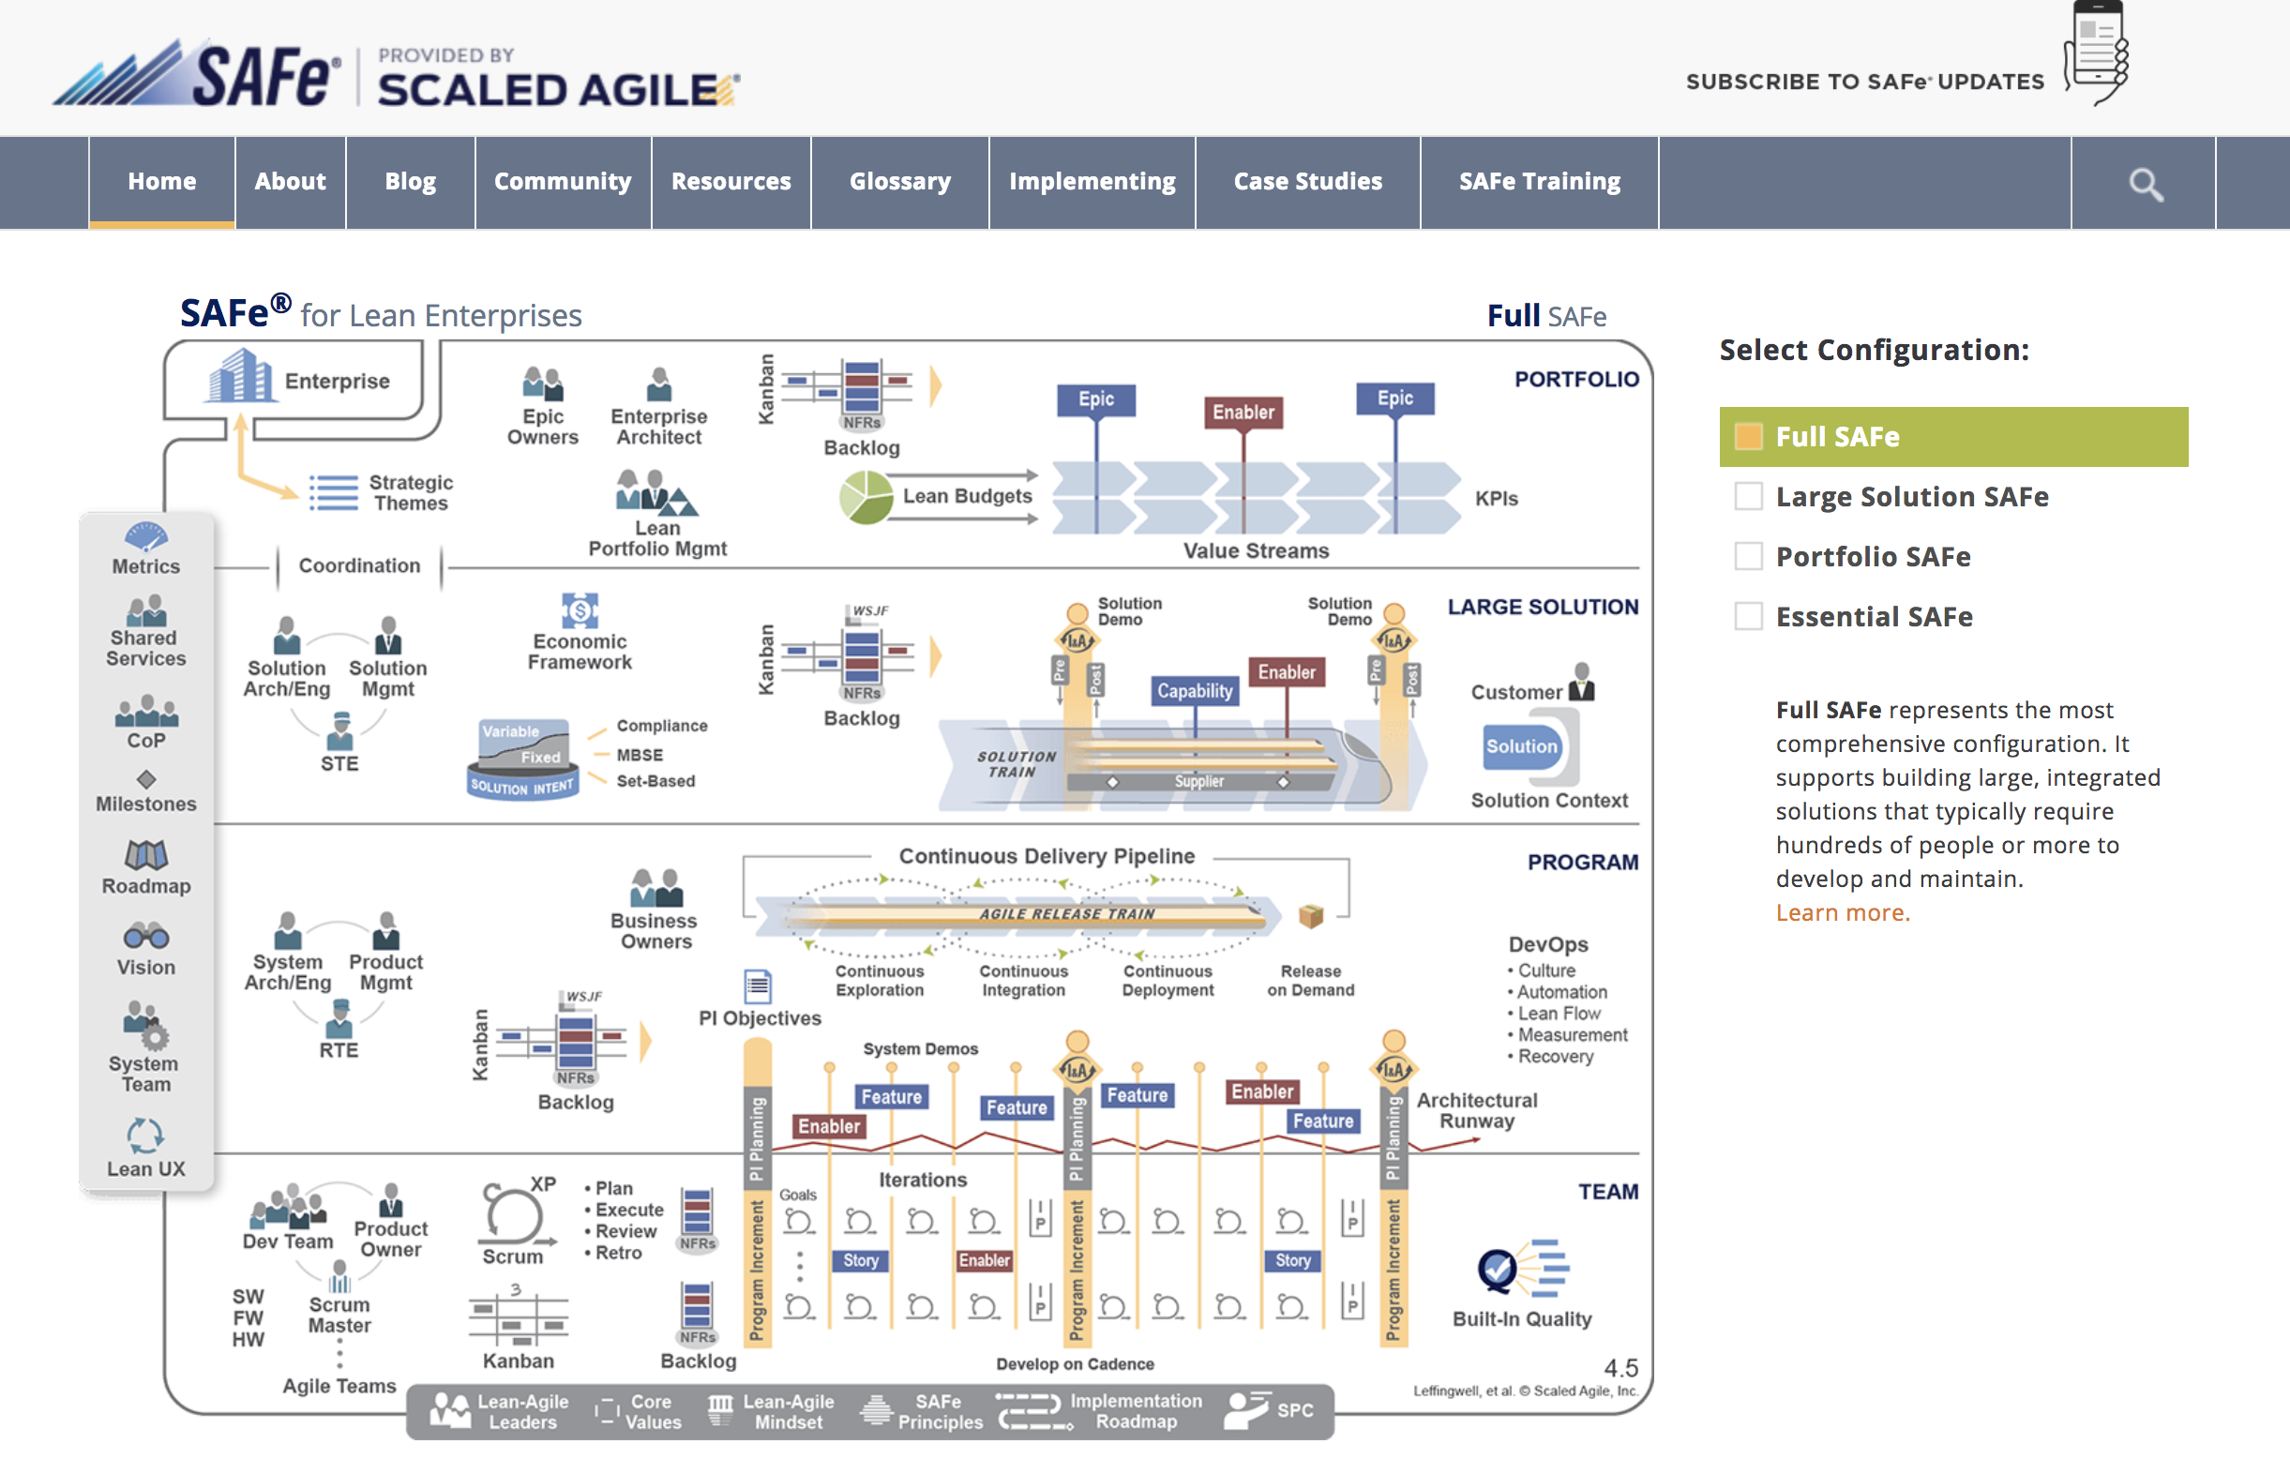
© Scaled Agile Inc 2016 All rights reserved

Slide 8
The Levels
© Scaled Agile Inc 2016 All rights reserved

Slide 9
© Scaled Agile Inc 2016 All rights reserved

Slide 10
The People
© Scaled Agile Inc 2016 All rights reserved

Slide 11
© Scaled Agile Inc 2016 All rights reserved
Notes:
OVERVIEW: In this slide, you can explain that, at first glance, the Framework may appear complicated. However, you can provide assurance that you will take them through it in a logical manner.
SAMPLE SPEAKER NOTES:
This is what is referred to as the “SAFe Big Picture”. At first, it may look complicated, but as we will see, it is actually a very straight-forward and logical representation.
We will see that roles, artifacts, and activities are clearly defined based on proven principles and practices.
Decomposing the SAFe Big Picture into it’s constituent parts, we’ll discover that it’s a simple, powerful and easily understood framework for managing complex software and systems development.

Slide 12
The Backlogs
© Scaled Agile Inc 2016 All rights reserved

Slide 13
© Scaled Agile Inc 2016 All rights reserved
Notes:
OVERVIEW: In this slide, you can explain that, at first glance, the Framework may appear complicated. However, you can provide assurance that you will take them through it in a logical manner.
SAMPLE SPEAKER NOTES:
This is what is referred to as the “SAFe Big Picture”. At first, it may look complicated, but as we will see, it is actually a very straight-forward and logical representation.
We will see that roles, artifacts, and activities are clearly defined based on proven principles and practices.
Decomposing the SAFe Big Picture into it’s constituent parts, we’ll discover that it’s a simple, powerful and easily understood framework for managing complex software and systems development.

Slide 14
© Scaled Agile Inc 2016 All rights reserved
Notes:
OVERVIEW: Here, you can introduce the Enterprise Backlog Model consisting of the Portfolio, Value Stream, Program, Team, and Sprint backlogs. You can also elaborate on the artifacts and roles which influence the creation and prioritization of the backlog items, such as Strategic Themes, the Vision, and the Roadmap.
SAMPLE SPEAKER NOTES:
There are four levels of backlogs which comprise the Enterprise Backlog Model: the Portfolio Backlog which contains Epics, Solution Backlog which contains capabilities, the Program Backlog which contains Features, and the Team Backlog which contains Stories
The backlogs contain prioritized functionality and enablers. Enablers are the exploration, architecture, and infrastructure needed to support the functionality.
Epics are identified and progressively elaborated as they flow through the Portfolio Kanban System. The Kanban System makes the strategic business initiatives visible and brings a structured analysis process driven by economics. There are Kanban Systems at the Value Stream and Program Levels, as well.
Epics are broken down into Capabilities. Prioritization is guided by the Vision and Roadmap. We’ll take about prioritization later.
Capabilities are broken down into Features.
Features are then broken down into Stories which are executed by the Agile teams.
However, this isn’t a strict hierarchy. A Capability, Feature, or Story may emerge within the context of the Value Stream, Program, or Team and not have a parent.

Slide 15
The Cadence
© Scaled Agile Inc 2016 All rights reserved

Slide 16
© Scaled Agile Inc 2016 All rights reserved
Notes:
OVERVIEW: In this slide, you can explain that, at first glance, the Framework may appear complicated. However, you can provide assurance that you will take them through it in a logical manner.
SAMPLE SPEAKER NOTES:
This is what is referred to as the “SAFe Big Picture”. At first, it may look complicated, but as we will see, it is actually a very straight-forward and logical representation.
We will see that roles, artifacts, and activities are clearly defined based on proven principles and practices.
Decomposing the SAFe Big Picture into it’s constituent parts, we’ll discover that it’s a simple, powerful and easily understood framework for managing complex software and systems development.

Slide 17
Build in Quality
© Scaled Agile Inc 2016 All rights reserved

Slide 18
© Scaled Agile Inc 2016 All rights reserved
Notes:
OVERVIEW: In this slide, you can explain that, at first glance, the Framework may appear complicated. However, you can provide assurance that you will take them through it in a logical manner.
SAMPLE SPEAKER NOTES:
This is what is referred to as the “SAFe Big Picture”. At first, it may look complicated, but as we will see, it is actually a very straight-forward and logical representation.
We will see that roles, artifacts, and activities are clearly defined based on proven principles and practices.
Decomposing the SAFe Big Picture into it’s constituent parts, we’ll discover that it’s a simple, powerful and easily understood framework for managing complex software and systems development.

Slide 19
Relentless Improvement
© Scaled Agile Inc 2016 All rights reserved

Slide 20
© Scaled Agile Inc 2016 All rights reserved
Notes:
OVERVIEW: In this slide, you can explain that, at first glance, the Framework may appear complicated. However, you can provide assurance that you will take them through it in a logical manner.
SAMPLE SPEAKER NOTES:
This is what is referred to as the “SAFe Big Picture”. At first, it may look complicated, but as we will see, it is actually a very straight-forward and logical representation.
We will see that roles, artifacts, and activities are clearly defined based on proven principles and practices.
Decomposing the SAFe Big Picture into it’s constituent parts, we’ll discover that it’s a simple, powerful and easily understood framework for managing complex software and systems development.

Slide 21
Value Delivery
© Scaled Agile Inc 2016 All rights reserved

Slide 22
© Scaled Agile Inc 2016 All rights reserved
Notes:
OVERVIEW: In this slide, you can explain that, at first glance, the Framework may appear complicated. However, you can provide assurance that you will take them through it in a logical manner.
SAMPLE SPEAKER NOTES:
This is what is referred to as the “SAFe Big Picture”. At first, it may look complicated, but as we will see, it is actually a very straight-forward and logical representation.
We will see that roles, artifacts, and activities are clearly defined based on proven principles and practices.
Decomposing the SAFe Big Picture into it’s constituent parts, we’ll discover that it’s a simple, powerful and easily understood framework for managing complex software and systems development.

Slide 23
But wait there’s more!

Slide 25
So what could possibly go wrong?!?

Slide 26
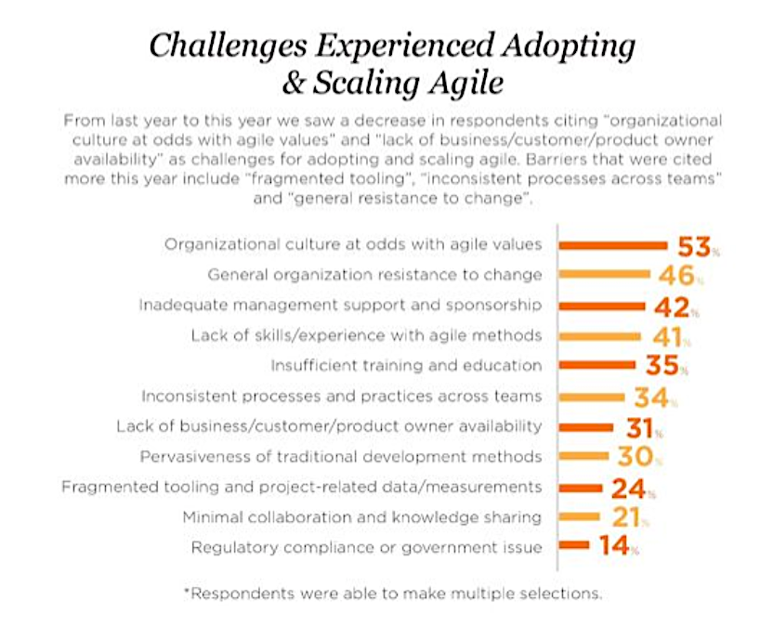

Slide 27
CoP’s
meetups
conferences
job aids
forums
training
fun

