Slide 1
Notes:
https://www.sharilevitin.com/blog-news/sales-presentations/ask-more-questions/
https://www.inc.com/lee-colan/4-questions-great-leaders-ask.html

Slide 2
Leading with powerful questions

Slide 3
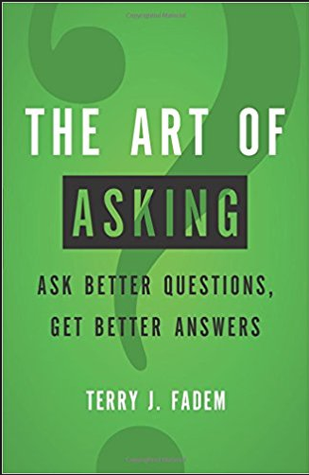
Why so many books on this subject?

Slide 4
Victim
“Can you stay curious a little bit longer and can you rush to action and advice just a little bit more slowly?”
-Michael Bungay-Stanier
Rescuer
Persecutor
The Coaching Habit: Say Less, Ask More, and Change the Way You Lead Forever.
Michael Bungay-Stanier
Notes:
https://www.forbes.com/sites/kevinkruse/2017/07/12/7-powerful-questions-every-leader-should-ask/#740fbe6e1874
Often people fall into one of the three corners on the triangle…there is another way, the way of coaching

Slide 5
People don’t really learn when they’re doing something, they learn when they have time to reflect
What’s on your mind?
And what else?
What do you think? How do you feel about...?
What’s most useful and valuable from our conversation today?
The Coaching Habit: Say Less, Ask More, and Change the Way You Lead Forever.
Michael Bungay-Stanier

Slide 6
“Telling creates resistance, asking creates friendships”
–Andrew Sobel

Slide 7
Workshop Scenarios
Notes:
SAFe calls these enablers – Infrastructure, Research/Exploration or Technical Capability (Architectural Runway)

Slide 8
Your team is missing a commitment for the third sprint in a row
A team member asks about working agreements and you know you’ve covered this multiple times before
Your manager requests your team’s velocity by EOD
Offshore meeting participants rarely talk in your meetings
Your team decides a core scrum ceremony is no longer necessary and wants it taken off the calendar

Slide 9
“Nobody cares how much you know, until they know how much you care.”
–Theodore Roosevelt
Notes:
This is critical…if you truly care about your team and want to help them often the technical side of all of this just naturally falls into place. Make it your goal to honestly want to do what’s best for each individual and you’ll be on the right trajectory. If you’re biggest concern if just getting stuff done then the team will always struggle to become a truly high performing team that exceeds expectations.

