Slide 2
Introduction to BDD

Slide 3
“BDD is a second-generation, outside-in, pull-based, multiple-stakeholder, multiple-scale, high-automation, agile methodology. It describes a cycle of interactions with well-defined outputs, resulting in the delivery of working, tested software that matters.”
-Dan North 2009

Slide 4
Where did BDD come from?
TDD was first
BDD better defined “what” to test

Slide 5
Core Concepts
uses dsl (domain specific languge)
leverage red/green/clean from TDD
usually integrated with a tool

Slide 6
Typical Specification has two parts
Story/Narrative
Who
What
Why
Acceptance Criteria
Initial condition
Trigger event
Expected Outcome
Often Gherkin (given/when/then)

Slide 7
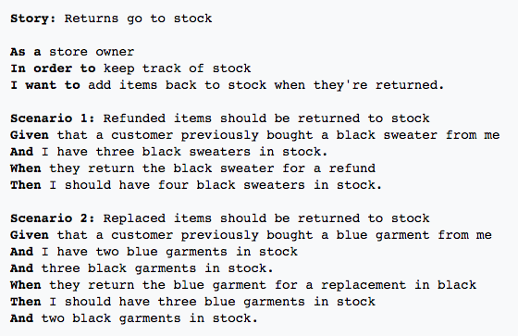
Examples

Slide 8
Specialized Tooling

Slide 9
What do the tools do?
Reads the document
Understands key words ex:“then”
Clauses transformed to test parameters with help from developers
Executes the test scenarios

Slide 10
Examples
Jbehave
Rbehave
Cucumber
Rspec
JDave

Slide 11
What are the benefits?
Better collaboration
High visibility – common language
Software design follows biz value
users more satisfied
More confident devs
Higher quality and lower cost

