Slide 1
Leading SAFe (SA)
Clearly define goals and desired outcomes
Train Leaders
Define Change Mgmt Group
Define Value stream
Localize implementation to best meet Value Stream Goals
SAFe
for
Teams (SP)
SAFe
Scrum
Master
SAFe
PMPO
SAFe
for
Teams (SP)
SAFe
Scrum
Master
SAFe
PMPO
Continuous Improvement
Build Backlogs
Launch Teams and Program
Role Training
Fill Roles
Notes:
Changed it from just one square of “coaching”…really a coache’s work is all the guiding all the green and blue boxes (not just that one)

Slide 2
Establish Change Management Group
This small group (3-5) will guide significant cultural change over the course of the transformation
This group needs to understand agile principles and should at least be SA certified
It’s best to have a cross section of the organization
Select Group
Set up agile tool to track activities
Schedule kickoff and communicate the goal
Schedule weekly 1 hour mtgs (move to bi-weekly in future)
Action Items
Considerations

Slide 3
Build Backlogs
Which 5 or so people should make up “product steering”? This will be the group that proposes and prioritizes features
Schedule mtg with product steering (3 hours)
Review program level kan ban
Review proposed feature list
Rank list using relative ranked WSJF
Schedule a mtg with IT to determine how many of the proposed items could make it into the upcoming quarter
Roughly size using planning poker
Compare to what was accomplished last quarter
Schedule ongoing 1 hour weekly mtgs with Product steering to serve as a continuous front door. These will be facilitated by the agile coach initially then turned over as quickly as possible once the right resource is identified.
Schedule PI planning to follow team based SP training
Setup program kanban in tool
Get agreement on metrics and ppt based review templates
Schedule quarterly executive reviews (2 hours end of quarter)
Are there any MVPs that can be released in this PI?
How can we bring value to end users, can we give them a demo or have them go live with partial functionality?
Can the features be written in such a way as to define true “slices of cake” instead of waterfall steps?
Action Items
Considerations

Slide 4
Form/Launch Teams
Given the type of features that are proposed, what is the best way to organize the teams so that dependencies are reduced as much as possible?
Fill SM and PO roles
Get agreement on team based metrics and cadence for reviews
Identify agile tool owner and trainer
Determine agile tool and team level configuration
Decision – If Jira will each team have one project or will they share a common project?
Decision – Define columns in team scrum board
Schedule and execute PM/PO training
Schedule and execute SSM training
Schedule and execute SP training
Schedule core scrum ceremonies
Sprint Planning (3 hrs for first one, 2 hours for subsequent every other Wednesday)
Sprint Demo (1 hour, every other Tuesday)
Sprint Retro (30 mins, every other Tuesday)
Backlog Refinement – as needed by PO
Schedule weekly PO sync (60 mins to start reducing to 30 mins after 3 iterations)
Schedule weekly Scrum of Scrums (60 mins to start reducing to 30 mins after 3 iterations)
What is the best way to organize cross functional teams?
Should the teams be based around a particular scope of work, or be true “feature” teams?
Which teams should be scrum and which Kanban? (How predictable is their work?)
Scrum teams should be 7 +/- 2
One PO can work with a maximum of 2 teams
One SM can work with a maximum of 3 teams
Each team should have only one PO and only one SM
Action Items
Considerations

Slide 5
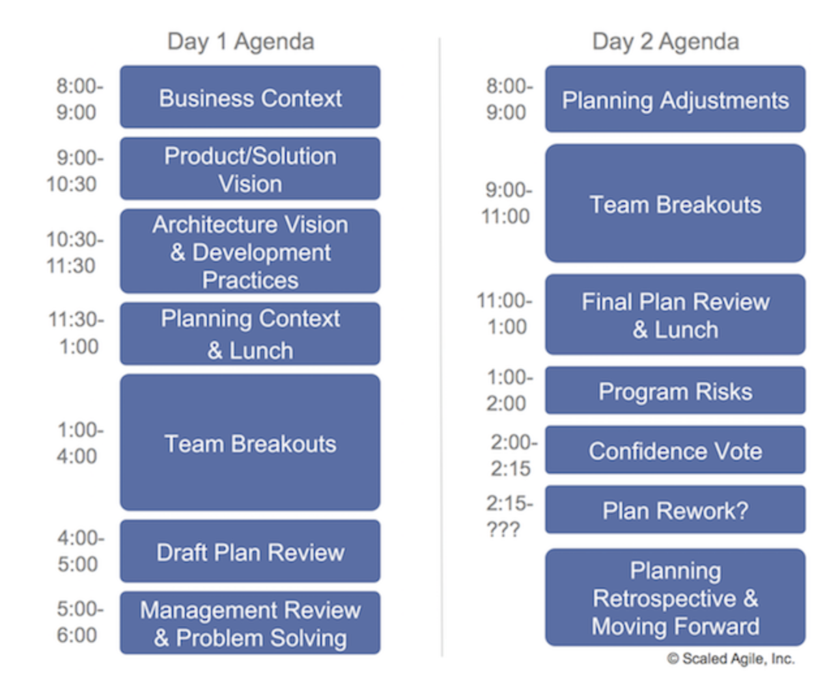
PI Planning Agenda
https://www.scaledagileframework.com/pi-planning/
Notes:
https://www.scaledagileframework.com/pi-planning/

