Slide 1
Definition of Ready

Slide 2
Definition of Ready
One reason teams don’t complete stories, features or epics is because they are poorly understood before starting work and as a result the effort is underestimated. In this situation often teams find clearly defining a “definition of ready” will help to make sure things are understood prior to commencing work
Why?

Slide 3
Backlog Prioritization
New
Description
Acceptance Criteria
Sized
WSJF
Prioritized Next
In Process
Done
Feature
Feature
Feature
Feature
Feature
Feature
Feature
Feature
Feature
Feature
Feature
Meets definition of ready

Slide 4
When is an Epic/Feature “ready”?
Has Definition statement
Has acceptance criteria
Sized and broken down to take 1-3 sprints roughly
Has WSJF calculation
Prioritized by leadership
What else would you add?

Slide 5
For (customers) Who (do something) The (solution) is a (how) that (provides some value) Unlike (competition or current solution) Our solution (does something better, why?)
Example Epic Description

Slide 6
Connected Kanban's
Epics at Portfolio Level
New
Prioritized
In Process
Done
Features at Program Level
New
Prioritized
In Process
Done
Stories at Team Level
New
Prioritized
In Process
Done

Slide 7
Who should be pulled in to participate in the process that gets Epics and Features to a state of ”ready”?

Slide 8
When is an Story “ready”?
Has user story statement
Has acceptance criteria
Gherkin defined
Sized and broken down to take 1-3 days roughly
What else would you add?

Slide 9
Discussion
When would tasking be part of the definition of ready? What are pro’s and con’s?
How would using spikes or enabler stories work with your model for definition of ready?
How will your team work together to help stories get to a “ready” state?

Slide 10
Definition of Done

Slide 11
Definition of Done
Newly formed teams will often have a broad variety of ideas when it comes to what constitutes “done”. As larger buckets of work are shipped this can create significant issues if assumptions go unexpressed and worse unfulfilled. Having a clear definition of ready at the Epic, Feature and Story level will help ensure expectations are met.
Why?

Slide 12
When is a Epic/Feature “done”?
Passes all acceptance criteria
No must fix defects
Pass E2E integration tests in staging
Release documentation updated
NFR’s met, engineering standards followed
Accepted by Product Manager
What else would you add?

Slide 13
Discussion
Are there other non IT teams you need to engage? (ex: Would sales marketing need to build documentation to support the release?)
What cadence will you demo these larger buckets of work?

Slide 14
When is a story “done”?
When is a Story “done”?
Passes all acceptance criteria and Gherkin
Automated tests written
Checked into version control
NFR’s met, engineering standards followed
Accepted by PO
What else would you add?

Slide 15
Examples

Slide 16
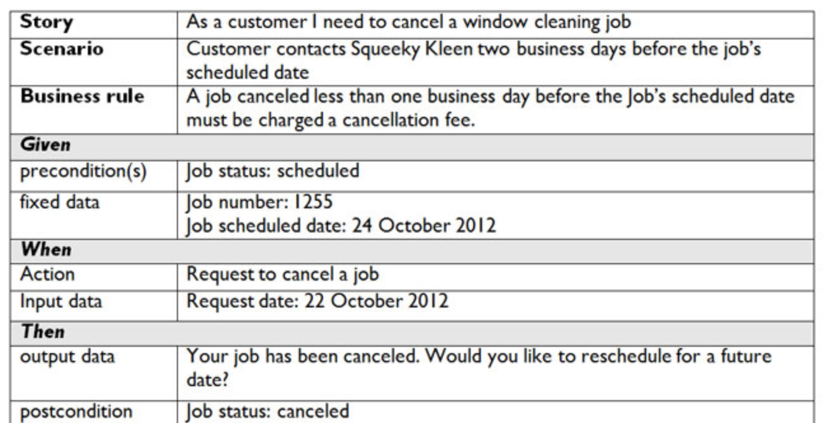
Story Examples

Slide 17
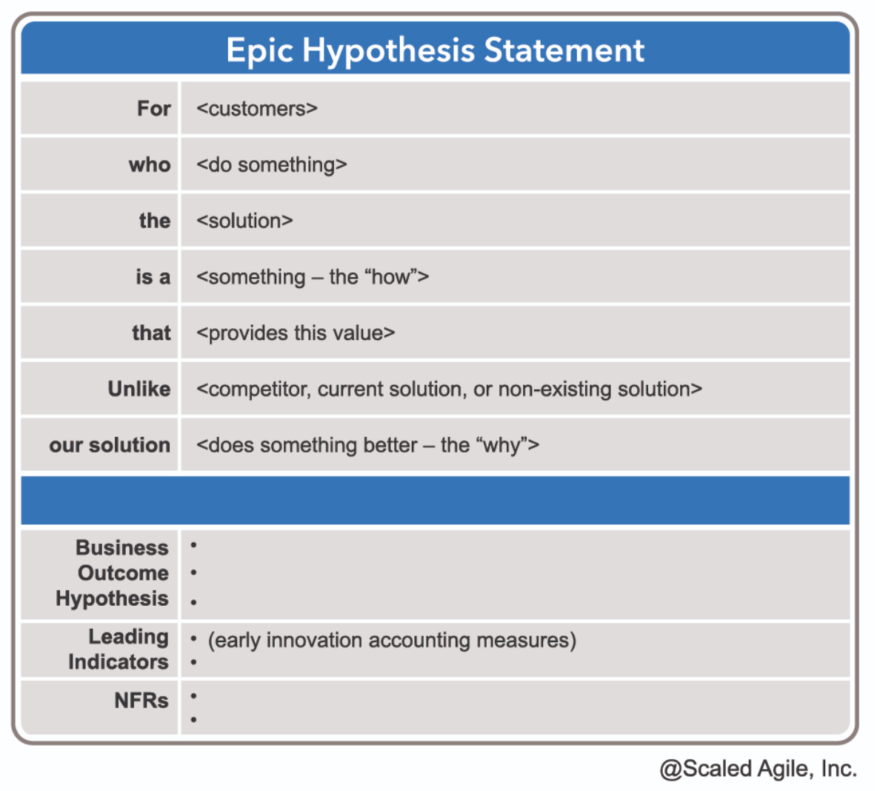
Epic Format Feature Format
Feature
In-Service Software Update
Acceptance Criteria
Nonstop routing availability Automatic and Manual Update Rollback Capability Support through existing admin tools All enabled services are running after the update
Benefit Hypothesis
Significantly reduce planned downtime
More Content on Epics
More Content on Features

