Slide 1
SAFe overview

Slide 2
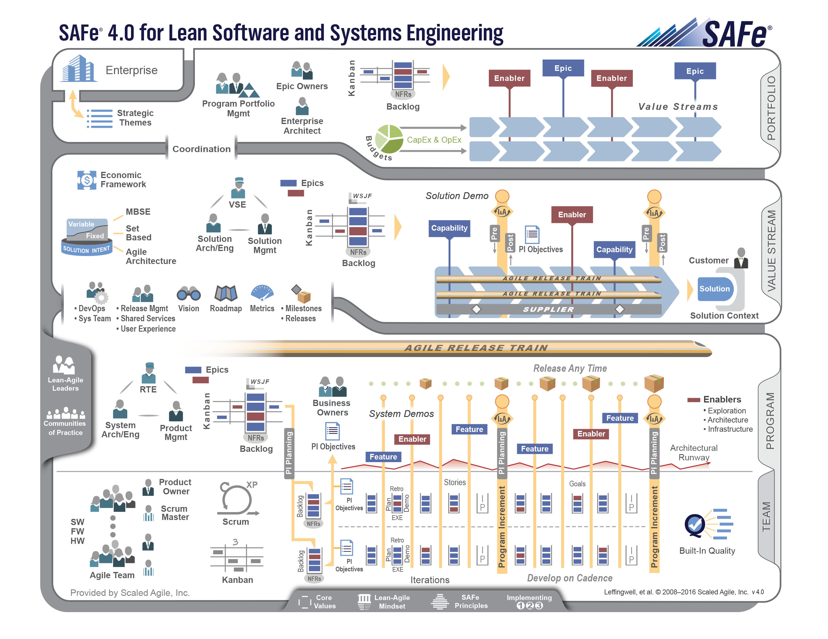
Notes:
OVERVIEW: In this slide, you can explain that, at first glance, the Framework may appear complicated. However, you can provide assurance that you will take them through it in a logical manner.
SAMPLE SPEAKER NOTES:
This is what is referred to as the “SAFe Big Picture”. At first, it may look complicated, but as we will see, it is actually a very straight-forward and logical representation.
We will see that roles, artifacts, and activities are clearly defined based on proven principles and practices.
Decomposing the SAFe Big Picture into it’s constituent parts, we’ll discover that it’s a simple, powerful and easily understood framework for managing complex software and systems development.

Slide 3
Proven
Notes:
OVERVIEW: With this slide, you can talk in general about the speed at which SAFe has been adopted, or adapt your voice-over to highlight its adoption in a specific market. See the case studies on the Scaled Agile Framework website.
SAMPLE SPEAKER NOTES:
SAFe is an online, freely revealed knowledge base of proven success patterns for implementing Lean-Agile software and systems development at enterprise scale. It provides comprehensive guidance for work at the enterprise Portfolio, Value Stream, Program, and Team levels.
Companies like John Deere, Intel, Lego, and Telstra have published case studies citing the business benefits. The list is growing every day. You can find those by navigating to ScaledAgileFramework.com and clicking on the “Case Studies” menu.
To find certified members of the SAFe community, navigate to ScaledAgile.com and click on the Community menu.

Slide 4
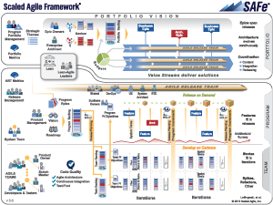
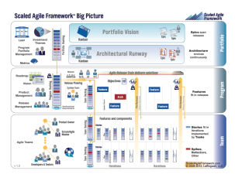
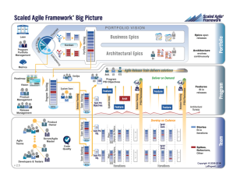
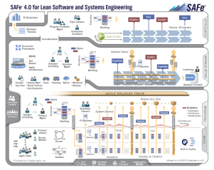
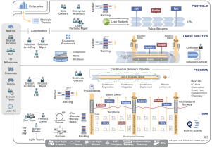
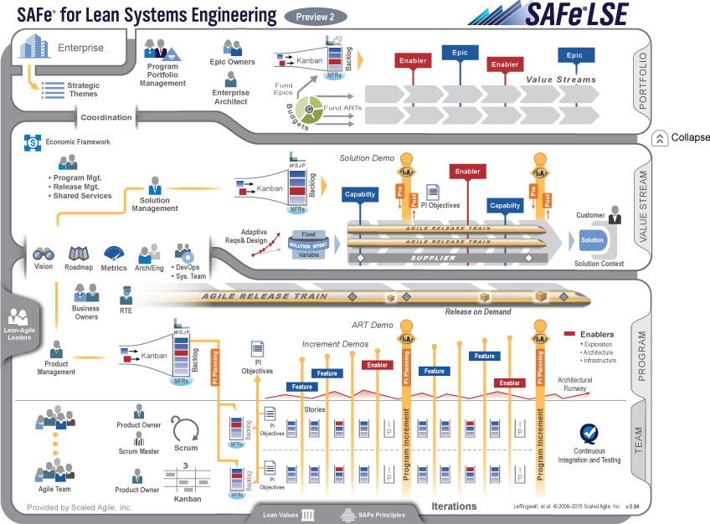
Roots, past, present and future
Field experience at enterprise scale
2011
Now…
3.0
4.0
4.5
1.0
2.0
LSE
Agile development | Lean product development | Systems thinking
Notes:
The Framework is based on a huge body of knowledge – Lean Thinking, Lean Product Development, Systems Engineering and Agile to name a few.
The knowledge of the Framework isn’t a one time learning event. It’s an on-going process.
The Framework is constantly being updated to stay current. Previously we’d release more frequent updates. Now there is once a year release cycle on the “Big Picture” .
Pace of innovation still remaining constant, we are still continually updating with what we learn. We’ve just slowed down the updates of the UI only (is updated annually)

Slide 5
The Levels
Notes:
OVERVIEW: Introduce the levels of the Framework. Based on your audience, you could introduce SAFe Principle number 9: Decentralize Decision-Making
SAMPLE SPEAKER NOTES:
The levels in SAFe are not structured for control; rather, they are for centralizing strategy and decentralizing execution based on the SAFe Principles.
You can learn more about the SAFe Principles at http://www.scaledagileframework.com/safe-lean-agile-principles

Slide 6
Notes:
OVERVIEW: Introduce the Portfolio, Value Stream, Program, and Team levels. The Enterprise icon is highlighted to represent the connection between the enterprise business strategy and a SAFe Portfolio
SAMPLE SPEAKER NOTES:
Here we see the four levels of SAFe: Portfolio, Value Stream, Program, and Team.
In the small to midsize enterprise, one SAFe portfolio can typically be used to govern the entire technical solution set. In the larger enterprise (those with more than 500 – 1,000 technical practitioners), there can be multiple SAFe portfolios, one for each line of business.
Each SAFe portfolio contains a set of Value Streams and the additional elements necessary to provide funding and governance for the products, services, and Solutions that the Enterprise needs to fulfill some element of the business strategy.
The Value Stream Level is intended for builders of large and complex solutions that typically require multiple ARTs, as well as the contribution of Suppliers. It is intended for enterprises that face the largest systems challenges, building multidisciplinary and cyber-physical systems that contain software, hardware, electrical and electronic, optics, mechanics, fluidics, and more. Not all organizations will need the Value Stream Level. (NOTE: If you are able to access the Scaled Agile Framework website, this would be a good time to demo the expand/collapse button)
The Team and Program Levels make up the long-lived, self-organizing virtual organization known as the Agile Release Train (ART). Without teams, there can be no program. The ART plans, commits, and executes together. The “Agile Release Train” metaphor is used to communicate several key concepts:
The train departs the station and arrives at the next destination on a reliable schedule, which provides for fixed cadence, standard ART velocity, and predictable planning (and in many cases, cadence-based releases).
All “cargo,” including prototypes, models, software, hardware, documentation, etc., goes on the train.
You’ll notice at the bottom the SAFe Core Values, Lean-Agile Mindset (represented by the House of Lean), and SAFe Principles. These articulate the time-proven principles upon which SAFe is based.
Also on the bottom is “Implementing 1-2-3.” Based on the learning from hundreds of SAFe implementations, this simple model is a proven success model.
Train implementers and Lean-Agile change agents
Train all executives, managers, and leaders
Train teams and launch Agile Release Trains
In training all executives, managers, and leaders, you create your Lean-Agile Leaders, whom you’ll see on the left.

Slide 7
The People
Notes:
OVERVIEW: Here, you can discuss the concept of the knowledge worker.
SAMPLE SPEAKER NOTES:
In knowledge-based work the people are truly the assets of the organization.
It is the people who have the knowledge and skills to define and build a quality system which executes the business strategy.

Slide 8
Notes:
OVERVIEW: Consider starting first with Lean-Agile Leaders. From there, you can tailor the discussion based on your audience. For example, if you’re speaking to an executive audience not familiar with Agile, you may want to continue with Program Portfolio Management and work your way down. If your audience is familiar with Agile, you could start with the teams and work your way up.
SAMPLE SPEAKER NOTES:
You’ll see Lean-Agile Leaders on the left. These are not specific people filling a specific role. Rather, they represent the leadership required across the organization, as guided by the SAFe Core Values, House of Lean, and Principles
Let’s now move to the Team Level
Here, we have small cross-functional teams that are empowered to make localized decisions to get work done. These teams may operate under ScrumXP or Kanban on software, firmware, or hardware. Each Agile team has a Scrum Master, Product Owner, Developers, Testers, and other necessary team roles.
Let’s move to the Program Level
The Release Train Engineer facilitates the activities of the Agile Release Train, much like the Scrum Master facilitates the activities of the team.
Product Management is responsible for the Program Vision and Roadmap. They prioritize the work in the Program Backlog, much like Product Owners do in the Team Backlog,
The System Architect/Engineer plays a critical role in helping align teams in a common technical direction toward accomplishment of the mission, Vision, and Roadmap.
Business Owners share responsibility for the value delivered by a specific Agile Release Train
The roles at the Value Stream level are similar to those at the Program Level
The Value Stream Engineer has responsibilities similar to those of the Release Train Engineer
Solution Management has responsibilities similar to those of Product Management
The Solution Architect/Engineer has responsibilities similar to those of the System Architect/Engineer
Let’s move to the Portfolio Level
We have the Program Portfolio Management team responsible for strategy and investment funding, program execution, and governance. They have the highest level fiduciary responsibility in the Framework.
The Enterprise Architect works across Value Streams and Agile Release Trains to provide strategic technical guidance in such areas as technology stack recommendations, interoperability of solutions, and hosting strategies
The Epic Owner is a role, not a title. This person takes responsibility for the business case and implementation guidance of initiatives, called Epics in SAFe
Are there any other roles of interest I didn’t mention?

Slide 9
The Backlogs
Notes:
OVERVIEW: If your audience is not familiar with the concept of a backlog, you can explain it now.
SAMPLE SPEAKER NOTES:
In Agile, requirements are managed in a construct known as a backlog which is comprised of prioritized functionality and enablers. Enablers are the exploration, architecture, and infrastructure needed to support the functionality.
Backlog items are elaborated at a level of detail appropriate to the phase of development.
They are not commitments. Rather, they represent opportunities.

Slide 10
Notes:
OVERVIEW: Here, you can introduce the Enterprise Backlog Model consisting of the Portfolio, Value Stream, Program, Team, and Sprint backlogs. You can also elaborate on the artifacts and roles which influence the creation and prioritization of the backlog items, such as Strategic Themes, the Vision, and the Roadmap.
SAMPLE SPEAKER NOTES:
There are four levels of backlogs which comprise the Enterprise Backlog Model: the Portfolio Backlog which contains Epics, Solution Backlog which contains capabilities, the Program Backlog which contains Features, and the Team Backlog which contains Stories
The backlogs contain prioritized functionality and enablers. Enablers are the exploration, architecture, and infrastructure needed to support the functionality.
Epics are identified and progressively elaborated as they flow through the Portfolio Kanban System. The Kanban System makes the strategic business initiatives visible and brings a structured analysis process driven by economics. There are Kanban Systems at the Value Stream and Program Levels, as well.
Epics are broken down into Capabilities. Prioritization is guided by the Vision and Roadmap. We’ll take about prioritization later.
Capabilities are broken down into Features.
Features are then broken down into Stories which are executed by the Agile teams.
However, this isn’t a strict hierarchy. A Capability, Feature, or Story may emerge within the context of the Value Stream, Program, or Team and not have a parent.

Slide 11
Notes:
OVERVIEW: Here, you can introduce the Enterprise Backlog Model consisting of the Portfolio, Value Stream, Program, Team, and Sprint backlogs. You can also elaborate on the artifacts and roles which influence the creation and prioritization of the backlog items, such as Strategic Themes, the Vision, and the Roadmap.
SAMPLE SPEAKER NOTES:
There are four levels of backlogs which comprise the Enterprise Backlog Model: the Portfolio Backlog which contains Epics, Solution Backlog which contains capabilities, the Program Backlog which contains Features, and the Team Backlog which contains Stories
The backlogs contain prioritized functionality and enablers. Enablers are the exploration, architecture, and infrastructure needed to support the functionality.
Epics are identified and progressively elaborated as they flow through the Portfolio Kanban System. The Kanban System makes the strategic business initiatives visible and brings a structured analysis process driven by economics. There are Kanban Systems at the Value Stream and Program Levels, as well.
Epics are broken down into Capabilities. Prioritization is guided by the Vision and Roadmap. We’ll take about prioritization later.
Capabilities are broken down into Features.
Features are then broken down into Stories which are executed by the Agile teams.
However, this isn’t a strict hierarchy. A Capability, Feature, or Story may emerge within the context of the Value Stream, Program, or Team and not have a parent.

Slide 12
The Cadence
Notes:
OVERVIEW: If your audience is not familiar with the concept of cadence, you can explain it now.
SAMPLE SPEAKER NOTES:
The cadence is the division of time (or timebox) that provides a “heartbeat.” Cadence is critical for synchronizing teams on the Agile Release Train.
All teams work on the same cadence (2 week iterations) to synchronize and align. Cadence, however, doesn’t just apply at the Team Level. It is key throughout the Framework

Slide 13
Notes:
OVERVIEW: Here, you can discuss the Iteration at the Team Level and the Program Increment, or PI, and Program Level
SAMPLE SPEAKER NOTES:
At the Team Level, the teams work in two week increments called Iterations. They begin each Sprint with planning and end with a demo and a retrospective
At the Program Level, the teams on the Agile Release Train work in 8 – 12 week increments, called Programs Increments, or PIs. A PI begins with a higher level planning event, called PI Planning, and ends with a demo and retrospective known as “Inspect and Adapt.”
The teams on the Agile Release Train develop on cadence, but can release any time based on business needs.
At the Value Stream Level, additional coordination activities may be required to align all Agile Release Trains (and Suppliers) in the Value Stream.
Are there any other questions about cadence and synchronization for alignment?

Slide 14
Build in Quality
Notes:
OVERVIEW: Here, you can explain the importance of bult-in quality to enable enterprise agility.
SAMPLE SPEAKER NOTES:
The Enterprise’s ability to deliver new functionality with the fastest sustainable lead time and to be able to react to rapidly changing business environments is dependent on Solution quality.
Built-in quality is not unique to SAFe. Rather, it is a core principle of the Lean-Agile Mindset, where it helps avoid the cost of delays associated with recall, rework, and defect fixing.
With respect to firmware and hardware, the goal is the same, but the physics and economics—and therefore the practices—are somewhat different. They include a more intense focus on modeling and simulation, as well as more exploratory early iterations, more design verification, and more frequent system-level integration.

Slide 15
Notes:
OVERVIEW: Here, you can explain built-in quality in the level of detail required by your audience.
SAMPLE SPEAKER NOTES:
Enterprise agility requires built-in quality. Throughout the Big Picture, you’ll see ways in which quality is achieved
At the bottom right of the Big Picture, you’ll note the Built-in Quality icon which describes the practices:
For software, continuous integration, test-first development, refactoring, pair work, and collective ownership
For firmware and hardware, exploratory early iterations, frequent system-level integration and testing, and design verification
Throughout the Framework, the role of the Architect or Engineer is seen as a first-class citizen. At the Portfolio Level, we have the Enterprise Architect; at the Value Stream Level, the Solution Architect or Engineer, and at the Program Level, the System Architect or Engineer. We also have User Experience designers, the System Team, and Release Management to insure quality.
Quality is confirmed through frequent demonstrations of the solution being built – the Team Demo, the System Demo, and the Solution Demo
Agile Architecture brings together architectural guidance provided by the Enterprise, Solution, and System Architects which is then validated by the Agile teams with short feedback loops as they build the Architectural Runway. Architectural Runway is the code needed to support near-term functionality, as described by Architectural Enablers.

Slide 16
Relentless Improvement
Notes:
OVERVIEW: Here, you can explain why the Framework uses the term “relentless improvement” rather than “continuous improvement.”
SAMPLE SPEAKER NOTES:
Continuous improvement is not enough. We need to be relentless with a sense of urgency and danger.
Events are built into SAFe to ensure this happens.

Slide 17
Notes:
OVERVIEW: Here, you can reference the House of Lean’s pillar of relentless improvement and explain how the Framework supports it.
SAMPLE SPEAKER NOTES:
One of the pillars of the House of Lean is relentless improvement. An enterprise is never agile; it is always becoming more agile.
There are multiple events which serve as forcing functions for relentless improvement. Each cross-functional team conducts a retrospective at the end of every sprint. In this retrospective, the team reflects on the good and the bad and collaborates on ways to improve.
Collectively, the entire Agile Release Train has a retrospective at the end of every Program Increment as part of the Inspect and Adapt Workshop. During this workshop, root cause analysis is used to identify Program Level problems and ways to improve.
An Inspect and Adapt Workshop also happens at the Value Stream Level.
Though everyone is responsible for relentless improvement, there are several key roles: the Scrum Master, the Release Train Engineer, and the Value Stream Engineer.
Lean-Agile Leaders remove impediments and continuously improve the system in which teams operate.
During the Innovation and Planning (IP) sprint, teams may have continuing education opportunities and “hackathons” where new approaches, tools, techniques, and prototypes are explored and demonstrated.
Fact-based metrics are used as feedback loops to measure the rapid progress towards working, high quality software which satisfies the needs of the business. Included in these metrics are how predictable teams are at meeting their PI Objectives.

Slide 18
Value Delivery
Notes:
OVERVIEW: Here, you can give an overview of how SAFe organizes around value and uses sound economic decision-making.
SAMPLE SPEAKER NOTES:
As a SAFe Principle, we want to take an economic view and make sound decisions at all time.
SAFe organizes around Value Streams to understand and deliver value
As Donald Reinertsen says in his book, The Principles of Product Development Flow, “You can ignore economics, but they won’t ignore you.”

Slide 19
Notes:
OVERVIEW: Here, you’ll discuss how the enterprise strategy is translated into a solution to maximize value to the customer. You may or may not go into detail based on your audience.
SAMPLE SPEAKER NOTES:
The connection between the enterprise business strategy and the Portfolio is through Strategic Themes. This brief list guides the Economic Framework, Budgets, and backlog decisions.
Budgets are allocated to Value Streams in order to decentralize decisions which can be made quickly and efficiently at the Value Stream Level. Would you like to hear more about Lean-Agile Budgeting?
Epics are progressively analyzed as they move through the Portfolio Kanban System to determine the most important initiatives to do at that given point in time. It also assures capacity matching.
Sequencing of Epics, Capabilities, and Features is driven by a Lean approach called Weighted Shortest Job First (WSJF) which looks at the cost of delaying one item in order to do another. It looks at both the cost of delay and the effort to complete it. Would you like to hear more about WSJF?
Prioritizing functionality is done by Program Portfolio Management at the Portfolio Level, Solution Management at the Value Stream Level, Product Management at the Program Level, and Product Owners at the Team Level. This approach requires an understanding of decentralized decision-making, which is SAFe Principle #9.
The Economic Framework is a set of decision rules that aligns everyone to both the mission and the financial constraints. SAFe’s first Principle is to take an economic view, which highlights the key role that economics plays in successful Solution development.
The Solution Intent is the evolving understanding of what needs to be built and how it should be built. It is often more economically beneficial to wait and explore options as facts surface due to the high cost of change later in the process. Set-based design practices help avoid committing too early to design and requirements
The business value delivered at the end of each Program Increment is assessed by the Business Owners to measure planned vs. actual. The business is responsible for prioritizing and the teams are responsible for delivering.
Finally, the business determines when a solution needs to be released, rather than the more rigid waterfall approach of delivering everything at the end.

Slide 20
Notes:
OVERVIEW: You can use this slide to bring thing “full circle” and summarize what your audience has learned. You can also pause here to take questions, or use the final slide which simply says “Questions?”
SAMPLE SPEAKER NOTES:
We’re back where we started.
We saw that roles, artifacts, and activities are clearly defined based on proven principles and practices.
After decomposing the SAFe Big Picture into it’s constituent parts, I hope we’ve learned that it’s a simple, powerful and easily understood framework for managing complex software and systems development.

Slide 21
4L-Questions
Questions?
Notes:
Questions?

Slide 22
2.2 Explore the Scrum Master and Product Owner roles

Slide 23
Roles: Scrum Master
Coaches the team
Ensures that the team follows Agile principles and practices
Facilitates processes and meetings
Removes impediments and barriers
Protects the team from external forces

Slide 24
The Scrum Master in the Enterprise
Coordinates with other Scrum Masters, the System Team, and shared resources in the ART PI Planning meetings
Works with the above teams throughout each Iteration and PI
Coordinates with other Scrum Masters and the Release Train Engineer in Scrum of Scrums
Fosters normalized estimating within the team
Helps teams operate under architectural and portfolio governance, System Level integration, and System Demos
Fosters adoption of Agile technical practices

Slide 25
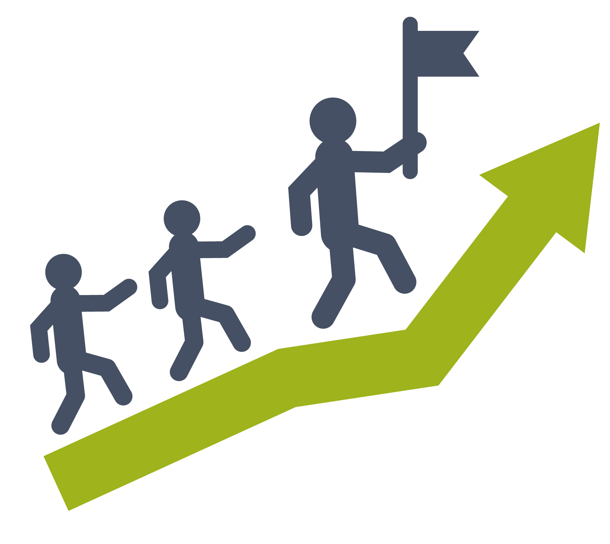
The Scrum Master is a servant leader
Listens and supports team members in problem identification and decision-making
Understands and empathizes with others
Encourages and supports the personal development of each individual
Persuades rather than uses authority
Thinks beyond day-to-day activities
Looks to help without diminishing the commitment of others
Coaches the team on Agile best practices
Notes:
The Scrum Master role is a special role for an Agile Team member who spends much of her time helping other team members communicate, coordinate, and cooperate; generally, this person assists the team in meeting their delivery goals:
The Scrum Master is a servant leader who helps teams self-organize, self-manage, and deliver via effective Agile practices.
The Scrum Master supports and coaches the practices, principles, and mindset of the SAFe and other process rules the team has agreed to.
The Scrum Master also helps the team coordinate with other teams on the Agile Release Train and communicates status to management as needed. Read more at: http://www.scaledagileframework.com/scrum-master/

Slide 26
Product Owner

Slide 27
Roles: Product Owner
Member of the Agile Team
A single voice for the Customer and stakeholders
Owns and manages the Team Backlog
Defines and accepts requirements
Makes the hard calls on scope and content
Notes:
Anyone can write stories and acceptance criteria. Otherwise, there’s a bottleneck. The PO owns prioritization, scope, and content.

Slide 28
The Product Owner in the Enterprise
Establishes the sequence of backlog items based on program priorities, events, and dependencies with other teams
Operates as part of an extended Product Management Team, usually reporting via a “fat dotted line” to Product Management
Understands how the Enterprise Backlog Model operates with Epics, Capabilities, Features, and Stories
Uses PI Objectives and Iteration Goals to communicate with management
Coordinates with other Product Owners, the System Team, and shared services in the PI Planning meetings
Works with other Product Owners and the Product Management team throughout each Iteration and PI
Notes:
There must be a trusting relationship between Product Management and the Product Owner because they, in a sense, have two bosses.

Slide 29
Product Owner responsibilities
Ensures Stories and Enablers meet the acceptance criteria
Stories are aligned to Vision, Features, and PI Objectives
Has content authority for the Team Backlog
Represents customers and stakeholders
Participates in Iteration ceremonies as a team member
Helps decompose Features into Stories and prioritizes the Team Backlog
Works with the System Architect and the Team to understand and prioritize Enablers
Is open to negotiations that will occur
Accepts the Stories as done
Notes:
The Product Owner:
Serves as the customer proxy and is responsible for working with Product Management and other stakeholders—including other Product Owners.
Defines and prioritizes Stories in the Team Backlog so that the Solution effectively addresses program priorities (Features/Enablers) while maintaining technical integrity.
Ideally, the Product Owner is collocated with the rest of the team, where they typically share management, incentives, and culture.
Also attends most relevant Product Management meetings about planning and Program Backlog/Vision refinement. Read more at: http://www.scaledagileframework.com/product-owner/

Slide 30
Candidates for the Product Owner role
Business Analysts (BAs)
Subject Matter Experts (SMEs)
Project Managers
Domain Experts
Architects
Notes:
Experts in this role have to be careful that they wear the PO hat, rather than the expert hat. (e.g., it would be an anti-pattern to argue with the team as a domain expert over Story point sizing.)

Slide 31
Product Owner attributes
Focused on delivering stories and enablers to the train, tasked with helping the team build the right things at the right time.
Ability to communicate
Good business sense
Technical foundation
Trust
Courage
Content authority
Notes:
Product Owner attributes:
Ability to communicate
Good communication skills. Translates user and business objectives into the level of detail suitable for implementation.
Good business sense
Working knowledge of the business domain to better understand and define user stories that deliver real value to the end users and establish priorities and appropriate tradeoffs for system functionality and performance.
Technical foundation
Effective scope triage requires the constant evaluation of technical, functional, performance and user-value tradeoffs. Prioritizing refactors and defects vs. new value stories is a critical skill in Agile.
Trust
Primary responsibility for prioritizing and managing the team backlog falls to this role.
The most essential attribute of the Product Owner / Product Managers is trust.
The teams have to trust the Product Owner to make hard calls on scope and to defend their interest in quality and functionality.
Product Managers must trust the Product Owner to faithfully represent their priorities.

Slide 32
The Product Owner in the Enterprise
Establishes the sequence of backlog items based on program priorities, events, and dependencies with other teams
Operates as part of an extended Product Management Team
Understands how to operate with Epics, Capabilities, Features, and Stories
Uses PI Objectives and Iteration Goals to communicate with management
Coordinates with other Product Owners, the System Team, and shared resources in the ART PI Planning meetings
Works with other Product Owners and Product Management throughout each Iteration and PI

Slide 33
Product Manager

Slide 34
The Agile Release Train
A virtual organization of 5 – 12 teams (50 – 125+ individuals) that plans, commits, and executes together
Program Increment (PI) is a fixed time box; default is 10 weeks
Synchronized Iterations and PIs
Aligned to a common mission via a single Program Backlog
Operates under architectural and UX guidance
Frequently produces valuable and evaluable System Level Solutions
AGILE RELEASE TRAIN DELIVERS SOLUTIONS
Define new functionality
Implement
Acceptance test
Deploy
Repeat until further notice. Project chartering not required.

Slide 35
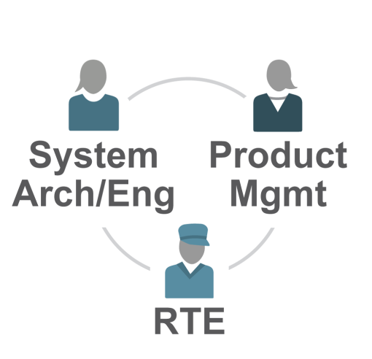
The ART roles
Three primary roles help ensure successful execution of the Vision and Roadmap initiatives at the Program Level:
The Release Train Engineer is a servant leader who facilitates and guides the work of the ART. He acts like a chief Scrum Master.
Product Management is the main content authority guiding the train. They own and prioritize the Program Backlog.
The System Architect/Engineer has the technical responsibility for the overall architectural and engineering design of the system. She provides architectural and technical guidance to the teams on the train.

Slide 36
RTE acts as the ‘Chief Scrum Master’ for the ART
Responsibilities of the RTE include:
Manage and optimize flow of value through the program
Facilitate PI Planning readiness and the event itself
Aggregate and communicate PI Objectives
Assist with execution and Features completion tracking
Assist with economic decision-making through Feature estimation and roll-up to Value Stream and portfolio
Escalate and track impediments
Foster collaboration between teams and system-level stakeholders; manage risks and dependencies
Drive relentless improvement via Inspect and Adapt

Slide 37
RTE-SM community supports ART execution
RTE is often best fit to assist Scrum Masters in removing systemic impediments
RTE and SMs see problems with the train/team structure firsthand
Together RTE and Scrum Masters are able to take a systems view of the Agile Release Train
Operating as a community is important:
Regularly meet to discuss problems
Exchange experiences

Slide 38
Exercise: Scrum Master responsibilities on the train
What are your responsibilities as a member of the ART Scrum Master/RTE community that go beyond basic Agile Team facilitation?
What challenges might you face in performing this aspect of your role?
Be prepared to discuss.
PREPARE
SHARE
3
min
5
min
Notes:
Exercise: Scrum Master responsibilities on the train
Purpose: Reviewing the Scrum Master responsibilities.
Setup: Learners will answer the questions at their tables, and then pair together to share their answers.
Process notes:
Have learners share their findings.
It doesn’t matter if learners are already part of SAFe implementation or not.
You can rephrase this exercise in terms of the community of program facilitators.
ASK:
“What are your responsibilities as a member of the ART Scrum Master/RTE community that go beyond basic Agile Team facilitation?”
“What challenges might you face in performing this aspect of your role?”
Key Learnings: Learners explain the basic responsibilities, and see themselves as part of such community rather than just an individual Scrum Master.
Timebox: 8 minutes. 3 minutes to prepare. 5 minutes to share.

Slide 39
Product Manager responsibilities
Collaborates and sets expectations with Product Owners, stakeholders, customers, architects
Can say ‘no’ in multiple directions: Stakeholders, Managers, LPM, and Product Owners
Prioritizes Features and negotiates Enablers in the Program Backlog using WSJF
Sets the Vision and Roadmap for the train
Has significant people skills and the innate ability to navigate the political landscape
Collaborates with the train to set scope
Accepts the Features as done
Notes:
The Product Management role:
Has content authority for the Program Backlog.
They are responsible for identifying customer needs, prioritizing Features and developing the program Vision and Roadmap.
Read more at: http://www.scaledagileframework.com/product-and-solution-management/

Slide 40
Product Manager attributes
Focused on the business aspects and the market at large, tasked with building the right Features at the right time.
Sense of balance
Forward thinking
Continuous exploration and understanding the customer’s needs
Solid understanding of current Solution
Trust
Notes:
Product Manager attributes:
Sense of Balance
There is a natural tension in the business that involves balancing the right amount of business vs. technology. A good product manager knows how to communicate and balance the two.
Forward thinking
Product Managers need to stay abreast of industry trends, understand the changing needs of the market and customers, and clearly articulate directions for addressing gaps and opportunities.
Solid understanding of current solution
Product Managers work with Solution Managers to have a continuous, in-depth understanding of how the current solution will satisfy the customer needs.
Trust
Primary responsibility for prioritizing and managing the program backlog falls to this role. The most essential attribute of the Product Owner / Product Managers is trust.

