Slide 1
PM/PO Role Discussion

Slide 2
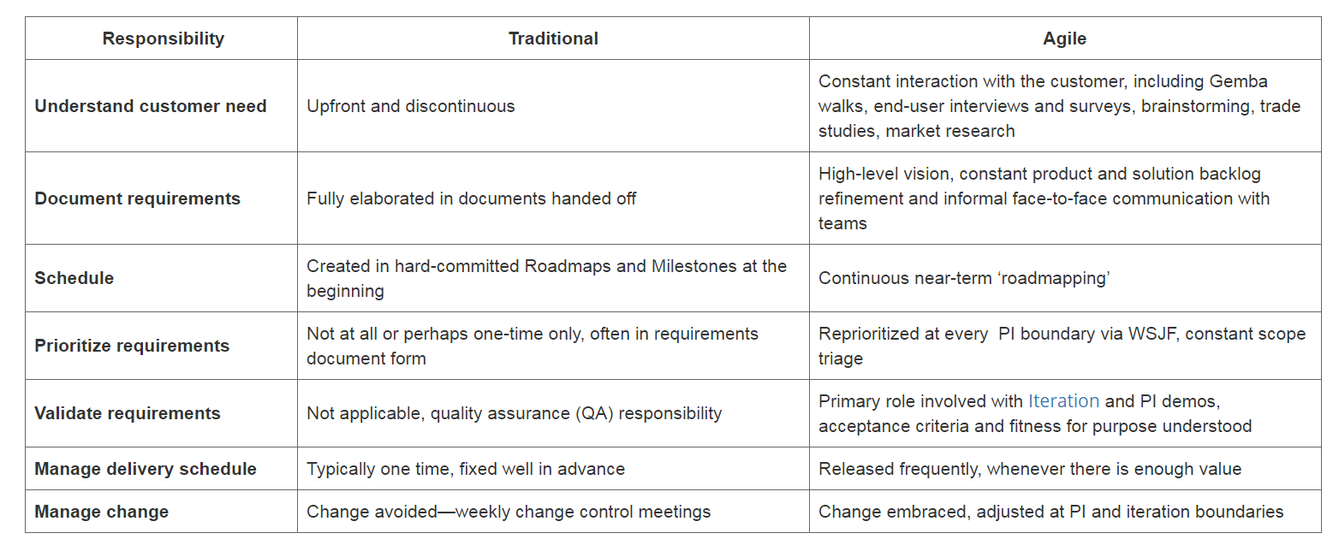
https://www.scaledagileframework.com/

Slide 3
https://www.scaledagileframework.com/

Slide 4
https://www.scaledagileframework.com/

Slide 5
SAFe Recommended Product Manager Attributes
Sense of balance
Forward thinking
Solid understanding of the current solution
Trust
agree or disagree?
Notes:
https://pollev.com/free_text_polls/XDIW6HlJSqHEAfz/web

Slide 6
SAFe Recommended Product Owner Attributes
Ability to communicate
Good business sense
Technical Foundation
Trust
Courage
Content Authority
agree or disagree?
Notes:
https://pollev.com/free_text_polls/XDIW6HlJSqHEAfz/web

Slide 7
does a BA have a role in an agile ecosystem?

Slide 8
https://www.scaledagileframework.com/
what are some anti patterns you would expect to see if these roles are not executed this way?

