Slide 1
rockin retros

Slide 2
what’s the deal with retro’s?
remember where you are
helps continue learning
look everywhere for opportunities
gives hope for a better future
this is a key foundation for success in anything
“Without continual growth and progress, such words as improvement, achievement, and success have no meaning.”
-Benjamin Franklin

Slide 3
the meeting itself
30-60 minutes
just the team, no mgmt
examine both qualitative and quantitative measures
everyone contributes
improvement items go in the backlog

Slide 4
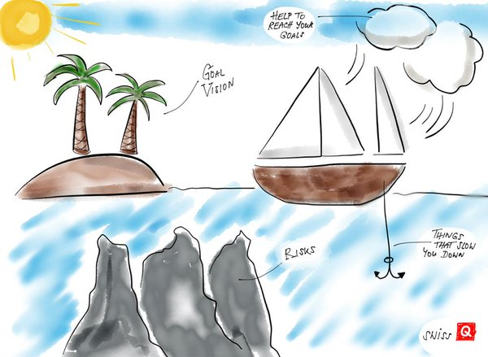
Notes:
Sailboat (first attachment)
The island represent the team’s goals/vision, we work every day to reach this island.
The rocks represent the risks we might encounter along the way.
The anchor on the boat is everything that has slowed us down this Sprint
The clouds and the wind represent everything that has helped us this Sprint

Slide 6
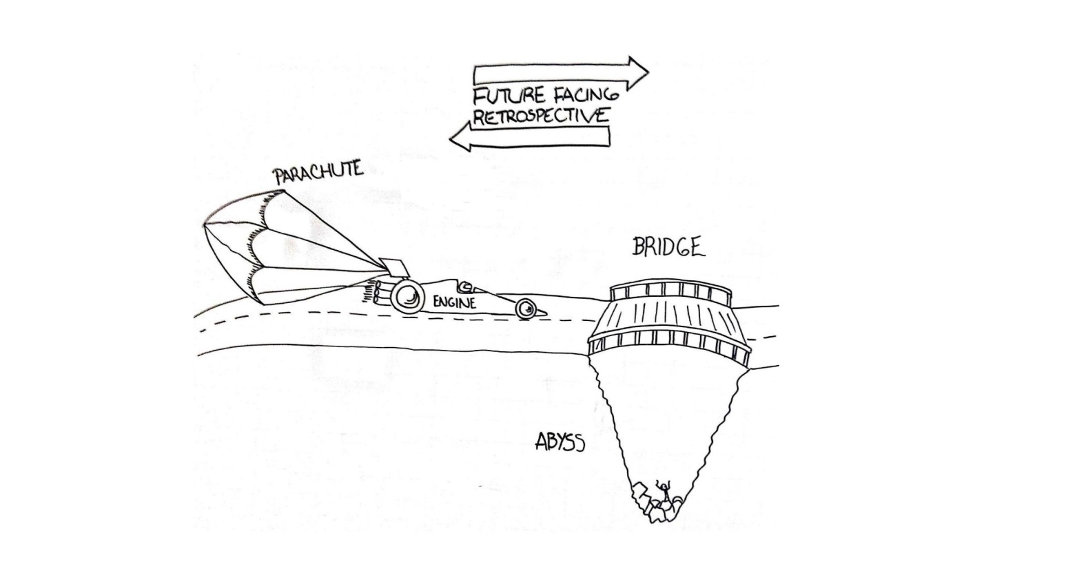
Notes:
Racing car / abyss (third attachment)
Looking Back
Engine: What have been pushing us forward? Making us move fast?
Parachute: What have been slowing us down?
Looking Ahead
Abyss: What are the danger ahead? What could take us down the role?
Bridge: What could we build to overcome such challenges? What shall we do to overcome the abyss?

Slide 7
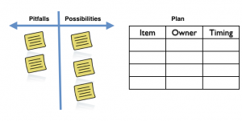

Slide 8
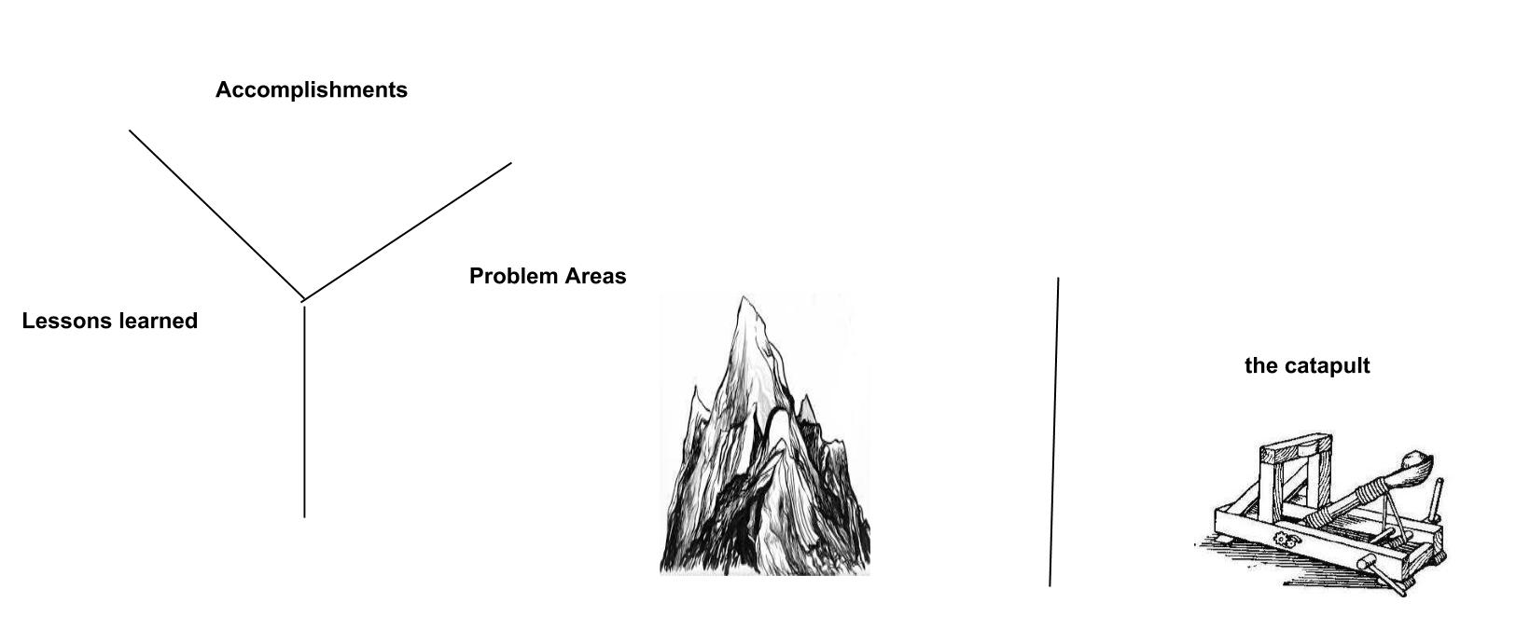
This example focuses on activities

Slide 9
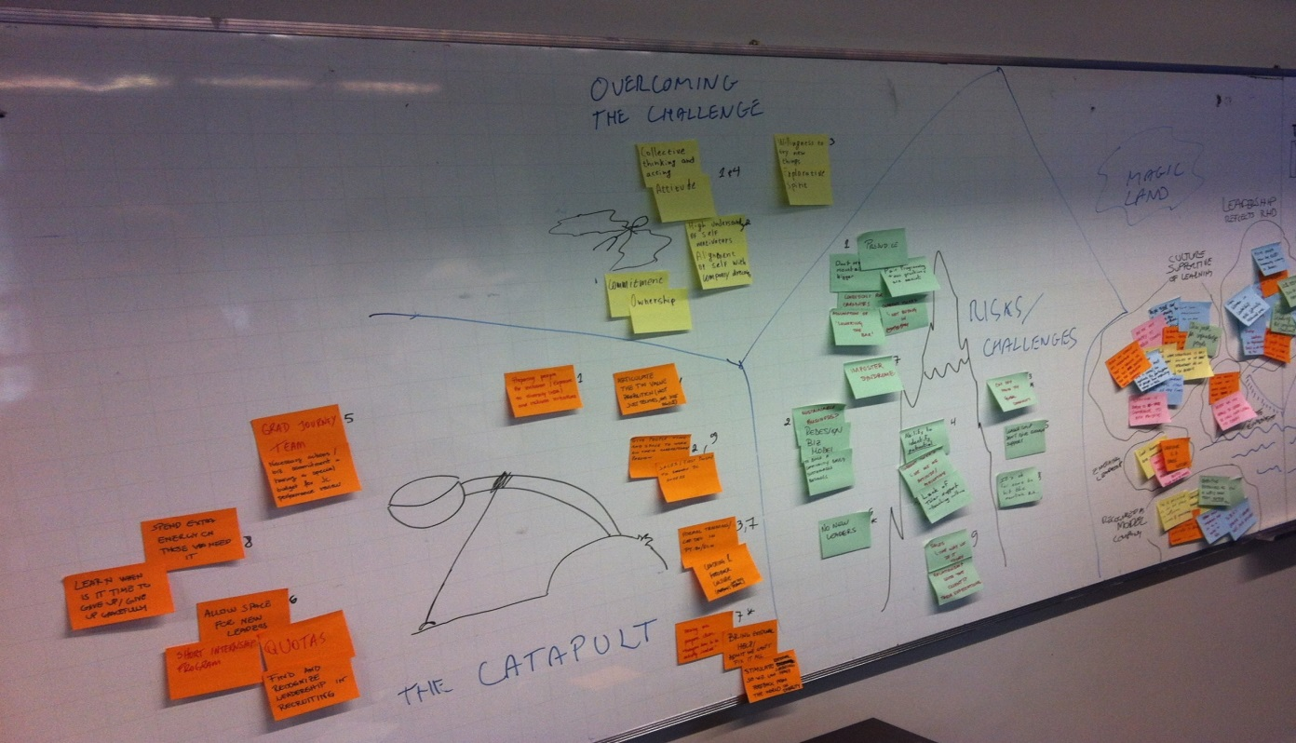
this example focuses on people
Notes:
The Catapult activity is great for planning and preparing for an upcoming challenge. With a simple metaphor, this activity guides the participants to look at the challenge from three perspectives: the person facing the challenge, the challenge itself, and the organization people engage in to overcome the challenge.
Running the activity
Draw the catapult, with the person flying and the mountain ahead.
Ask the participants to write notes for each of the three areas
The catapult: notes related to the organization preparing people to overcome the challenge,
Person flying: notes related to the person facing the challenge
The mountain: the challenge itself.
Conversation about the notes. Consider guiding the conversation by connecting related notes from the three areas.
Catapult activity sample result
Note on the photo above the nirvana or magic land behind the mountain (colored post its on the right of the picture) . The catapult activity builds up on the assumption that people are trying to reach the magic place, the nirvana. If the nirvana is not clear, please consider running an activity for defining it (such as Defining Nirvana) .

Slide 10
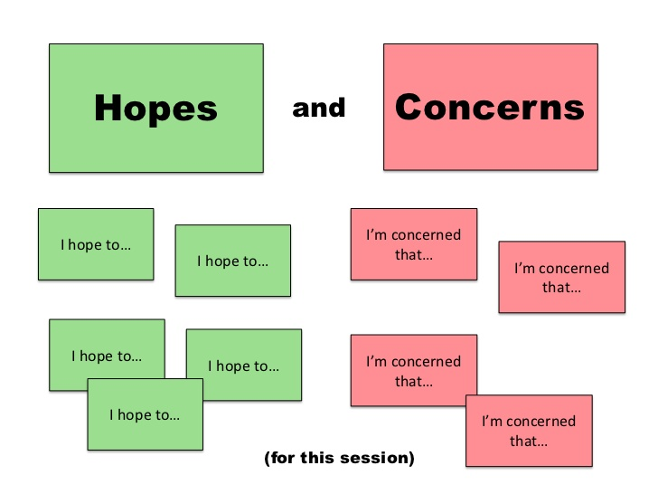

Slide 11
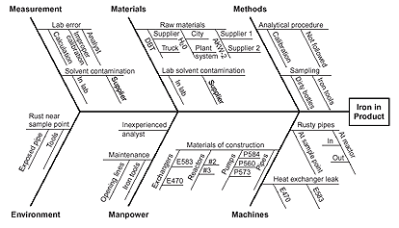
Tools
Program
Environment

Slide 12
prob
got a speeding ticket
Why
left home late
Why
woke up late
Why
alarm didn’t work
Why
phone/alarm battery died
Why
defective Cable

Slide 13
Other “grab bag” ideas
rate the iteration 1-5
limit to one word to describe the sprint
appreciations, focus one week on positive uplifting things

