Slide 1
the power of deduction with velocity and burndown charts

Slide 2
Do you have what it takes to be the
SHERLOCK of Scrum?

Slide 3
What would help them?
What are root causes?
Notes:
Dev and QA not done in a single sprint

Slide 4
Notes:
Point inflation – Manager says “I want more points!”

Slide 5
Notes:
external force of some type dumped major scope change, team got distracted…lot’s of WIP but not much completion

Slide 6
Notes:
Bad tool or don’t know how to use the tool

Slide 7
Notes:
Sandbagging team…also unrealistic commitments, someone is gaming the system

Slide 8
Notes:
This is about right…nothing too bad here

Slide 12
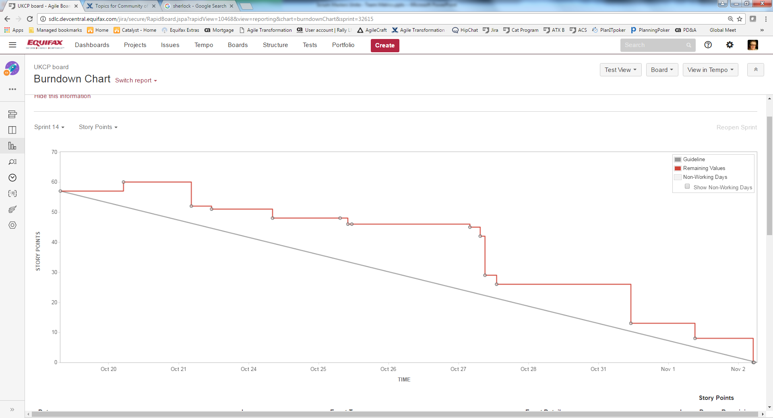

Slide 13
How do these get you traction with the team?
How can this data help you and your team?

