Slide 1
how do we sustain and deepen an agile transformation?

Slide 4
Why do transformations regress?

Slide 5
how do people change?

Slide 6
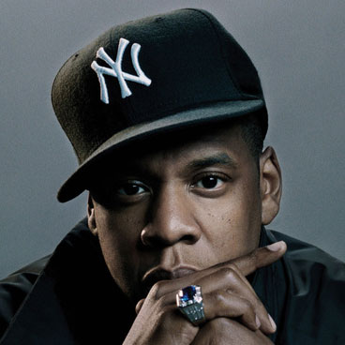
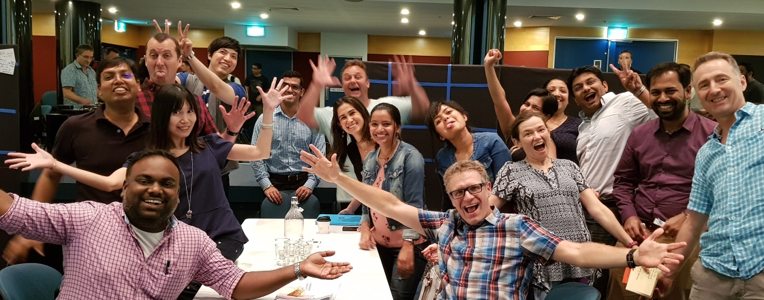
“we change people
through
conversation…”
-Jay Z
“conversations happen best in community”
-Danny P

Slide 7
What is a CoP?

Slide 8
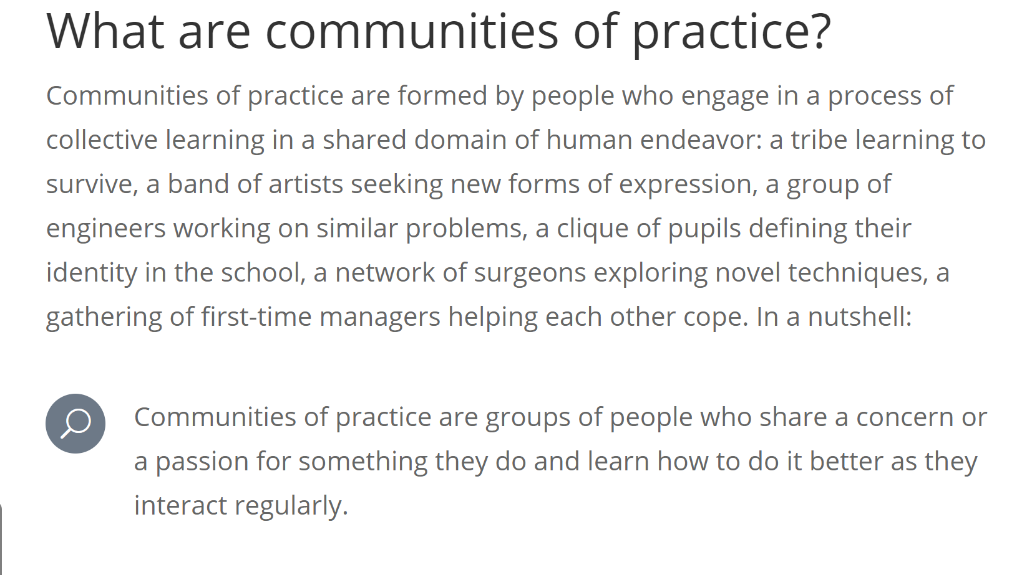

Slide 9
“communities of practice are groups of people who share a concern or a passion for something they do and learn how to do it better as they interact regularly
-Etienne Wenger

Slide 10
things you may hear…
“I’m stuck can we brainstorm some ideas?”
“where can I find some info about how to do…”
“here’s some materials I developed last year feel free to start with those and tweak from there”
“what do you think of that new ALM tool? Does it help?”
“who knows what and what are we missing? is there another group we need to connect with?”

Slide 11
What is the right mix for a CoP?

Slide 12
peers in your group
cross company peers
cross domain

Slide 13
What is the right size for a CoP?

Slide 14
Lewis and Clark
Jobs, Woz, Wayne
Beatles
Walt and Roy
3 Stooges

Slide 15
conversation
ease to prep
sustainability
get in motion
frequency
excitement

Slide 16
let’s go

Slide 17
CoP’s
meetups
conferences
job aids
forums
training
fun

