Slide 1
CoP kickoff

Slide 2
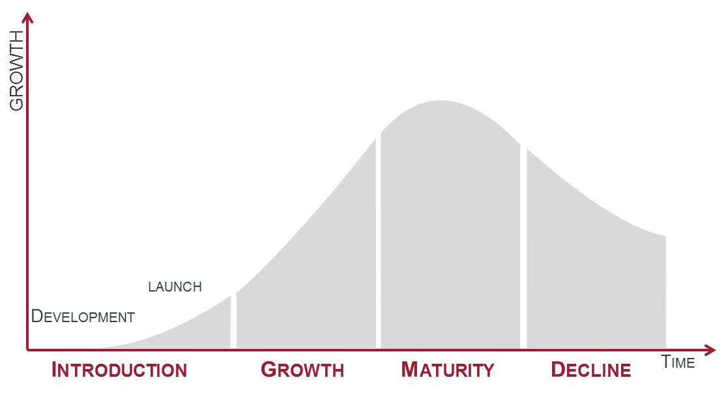
why be in a CoP?
“Without continual growth and progress, such words as improvement, achievement, and success have no meaning.”
-Benjamin Franklin

Slide 3
Communities of Practice (CoPs) are groups of people who share a concern or a passion for something they do and learn how to do it better as they interact regularly.¹
action
group
area of concern
¹Wenger, E. (1998). Communities of Practice: Learning, Meaning, and Identity. New York, NY: Cambridge University Press.
Notes:
Let’s start with a definition of “communities of practice” that comes from Etienne Wenger, the seminal author and creator of the term.
The Domain. The shared area of interest that brings people together. Members have a commitment and shared competence that distinguishes them from other people. (ex. automated testing)
The Community. Members build relationships through joint activities and discussions, help each other, share information. Regular interaction is vital to establishing a sense of community. Participation is voluntary…people self-select what communities they want to participate in, and to what degree they want to be involved. If a community is not providing value, they vote with their feet (like open space)
The Practice. Members are practitioners with a shared repertoire of experiences, stories, tools, and best practices. CoPs cooperatively develop the knowledgebase used by all members of the community.
Question: Is an agile team a CoP?
Answer: No. One of the key elements of a CoP is that participation is voluntary. Forced participation lowers commitment. Also, truly effective communities emerge from interactions between practitioners across the organization, not just the people you work with every day. Cross-pollination is the secret sauce of community.
Transition to the next slide: For those who have had a community of practice experience, give me some one word descriptions of what it was like to be in a healthy community (write down what they shout out on a flip chart) Click to next slide.

Slide 4
Word Cloud: Imagine you’re in 2019 and have been in this CoP for a year, write a a few words describing it (benefits, feel, etc)

Slide 5
What other things would you like to get out of this time?

Slide 6
What frequency would you like to meet?

