Slide 1
how do we sustain and deepen an agile transformation?

Slide 2
Why do transformations regress?

Slide 3
how do people change?

Slide 4
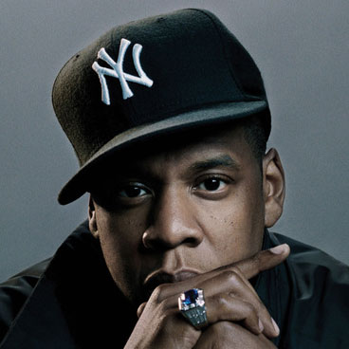
“we change people
through
conversation…”
-Jay Z

Slide 5
storytime…

Slide 6
What is the right size for a CoP?

Slide 7
Lewis and Clark
Jobs, Woz, Wayne
Beatles
Walt and Roy
3 Stooges

Slide 8
conversation
ease to prep
sustainability
get in motion
frequency
excitement

Slide 9
What is the right mix for a CoP?

Slide 10
peers in your group
cross company peers
cross domain

Slide 11
let’s go

