Slide 1
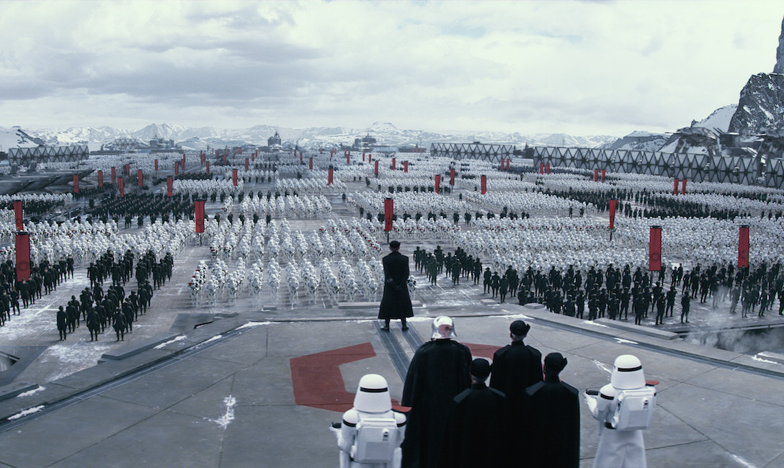
our journey toward top down support for agile transformation

Slide 2
where are you on your journey?

Slide 3
what are some of the challenges you’re dealing with?
what would you like to get out of this session?

Slide 4
where are we currently
Notes:
We haven’t officially arrived
No secret sauce
leadership has moved from “should we do agile” to “we should do agile”
hopefully you’ll be able to benefit though

Slide 5
investment in architectural runway
began training SAFe to teams
transformation metrics
expand footprint
2014
2015
2016
2017
many independent starts with mixed results
more business engagement
better results at the program level
formal approval for funding teams
increase staffing

Slide 7
DevOps
Reorganize Value Stream
Scale Platforms
Most of the enterprise is here
Engineering Practices
Traditional Waterfall
Iterative Waterfall
Team Level Scrum
Business Agility
Lean Kan Ban
Speed to Revenue
Prioritize Highest Business Value First
Predictability and Transparency

Slide 8
goals
create basis for agile ecosystem
fix current state dysfunctions
don’t over prescribe, balance emergent and intentional practices
be objective and measurable
pass-through point for higher levels of scrum
Notes:
Create Guardrails Create a way to provide guardrails for SCRUM teams (not Kanban)
Objective as much as possible – Demonstrate something, fact based. Should get the same result no matter who does the assessment
Prescribe just enough to make sure teams and enterprise are successful
Create a preferred future state…we don’t have to accommodate dysfunctions in current state
Create criteria to “get in the scrum club”…there will be higher and lower functioning teams, but all teams must demonstrate the following

Slide 9
roles
team
this is a journey all key stakeholders take together with hands on coaching along the way
program
portfolio

Slide 10
roles
Product Manager
Product Owner
Scrum Master
team
Right size and makeup
Core Ceremonies
Predictable Velocity
Meet story level commitments
program
Front door prioritization process
Build Program Board
Meet feature level commitments
portfolio
Annual Business Case
New flow based metrics
Notes:
Get HR involved to define new roles

Slide 11
 | Team |  |  |  |  |  |  | Program |  |  | Portfolio
Team | Product Mgr Role | Product Owner Role | Scrum Master Role | Team Composition and Size | Core Ceremonies | Predictable Velocity | Meeting Commitments | Quarterly Prioritization | Program Board | Predictable Delivery | Annual Business Case | Agile Metrics
Bullseye
BAM
Out of Memory
Thunderhead
Rogue Ones
Summer Camp
Essentials
Bondi
Manly
Falcon
Eagle
Jefferson
Einstein

Slide 12
Transformational Approach
Hands on Coaching
Comprehensive Training
Drive Aligned Agile Methodology & Tools
Secure Team and Funding
Cultural Change Management
Understand Current Environment
Clearly Define Success Metrics

Slide 13
Implementation Strategy
Implementing
SAFe (SPCs)
Leading SAFe (SA)
Train
Lean-Agile
Change Agents
Train
Executives
and Leaders
Define
Intentional
Practices
Leading SAFe (SA)
Prioritize
Group for
Transformation
Understand current state environment
Train
Local Leaders
Define Value stream
Localize implementation to best meet Value Stream Goals
SAFe
for
Teams (SP)
SAFe
Scrum
Master
SAFe
PMPO
SAFe
for
Teams (SP)
SAFe
Scrum
Master
SAFe
PMPO
Continuous Improvement
Build Backlogs
Launch Teams and Program
Deliver Explicit Knowledge
Fill Roles
Notes:
Changed it from just one square of “coaching”…really a coache’s work is all the guiding all the green and blue boxes (not just that one)

Slide 14
Helpful
SAFe as a framework
Internal designations
Stories both good/bad
Enterprise coaching
Celebrating wins
Investment in architectural runway
Swag
Wish we had…
More Communication
More 1:1 with middle mgmt
Plan for ppl to move
Say “no” more
Preserve margin
Clear SLT owner
Notes:
Helpful
SAFe as a framework
Got finance involved early
Internal designations
stories both good/bad
Enterprise coaching
Celebrating wins

Slide 15
what are next steps you need to take?

